Slide 1
Managing the Reading Block
District Learning Day
Location goes here
Session time goes here
August 6, 2015

Slide 2
Norms
Be present and engaged.
Be respectful of differences in perspective while challenging each other productively and respectively.
Monitor “air time.”
Make the most of the time we have.
Stay focused on students.
Notes:
Keep this slide – do not alter
We will adhere to the following norms.

Slide 3
Objectives
Teachers of Literacy will…
Know- how to effectively develop and implement a classroom management system for instructional and behavioral purposes. They will also know the purpose of the 90-minute Literacy block and how it supports CLIP and the Destination 2025 goal.
Understand- how to develop rules and routines to ensure that expectations are clear for students. They will understand the expectations for each segment of the 90-minute Literacy block (whole group, small group, whole group closure).
Do- describe a variety of instructional routines that support students’ literacy development for the components of the 90-minute Literacy block.

Slide 4
Classroom Routines

Slide 5
Classroom Routines
In order for active student engagement to occur, teachers need to develop effective classroom management routines.

Slide 6
Classroom Management Studies
Successful teachers integrate their classroom rules and procedures into their instruction systematically so that they become part of the curriculum and classroom environment.
Management styles
Rules and procedures
Coping with constraints
Room arrangement
Interruptions

Slide 7
Direct Teaching
Pre-planning of management routines:
Room arrangement
student seating
placement of materials
Whole and small group areas
Establishing rules and procedures
(ask 3 before me, etc.)
Clear expectations
Quick transitions (timer, music, chime, countdown)
Reduce teacher talk (hand signal, cue)
Notes:
Routines must be explicitly taught. Procedures, cues, etc. must be practiced to have a successful reading block.

Slide 8
Direct Teaching
Teaching Routines Systematically
Modeling
Practice
Review
Reinforce

Slide 9
Let’s Share!
Turn and talk with a partner about effective routines you have used.
What are some reasons you have changed or tweaked your routine?
What silent cues have been successful in your practice?
Notes:
Give participants time to discuss. Have them share out, and chart their responses.

Slide 10
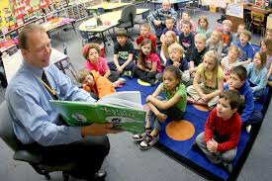
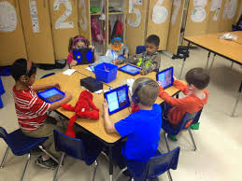
Literacy Block
Notes:
As we move into the Literacy Block, we want to keep in mind some of the various routines for management we have just discussed.

Slide 11
The Gradual Release of Responsibility (to introduce or reinforce a new skill)
Teacher Responsibility
I do it.
Guided
We do it.
They do it (together).
Collaborative
Independent
You do it (independent of the teacher).
Student Responsibility
Notes:
You should have seen this slide before. This is the model we will be using for all of Reading/Language Arts instruction. Across the instructional time frame, there needs to be a balance of teacher-directed instruction, teacher and student shared work, collaborative work among students, and student-initiated practice and application. At each phase of the process, the teacher removes some of the scaffolding and provides more opportunities for students to take responsibility for their learning.

Slide 12
Literacy “Look Fors”-Grades PreK-5
Clear objectives
For literacy and language learning
Thread throughout the block
Differentiated instruction in teacher-led small group
Flexible groups based on data
Guided reading or skills-focused lessons
Varied planning for different tasks for each group
Students working COLLABORATIVELY in small groups, not just side-by-side, to assist each other and reach deeper, shared understanding of texts and tasks
Explicit teaching of decoding at least through the end of third grade
Phonemic warm up
Teach sound/spelling
Practice blending
Apply to decodable text
Notes:
When observing during reading instruction, leaders should be aware of many different things. The objectives for each activity should be clear and tied to what was taught during whole group instruction. If the teacher worked on decoding multisyllabic words during whole group, opportunities to practice, apply, and extend that learning should occur during independent work time, as appropriate to the skills levels of individual students. During the teacher-led small group, the teacher should be working on that same skill or a not-yet-mastered precursor to that skill, as appropriate to the needs of the small group.
Explicit teaching of decoding through the end of third grade
Teach letter name, letter shape, and letter sound
Students should be involved in activities that required them to see, hear, and say the sounds
Segmenting and blending sounds
Students should also work on high frequency words and sight words (e.g, those words that have truly irregular phonics patterns)
By the end of third grade, students need to be able to decode multisyllablc words and apply knowledge of common roots and affixes to help them decode.

Slide 13
More Literacy “Look Fors”- Grades PreK-5
Teacher directly and explicitly modeling new skills and students practicing what he/she has done
Student access to quality text
Variety of fiction and nonfiction texts (decodable, leveled, on-grade, and stretch texts)
Students engaged with text by tracking print, highlighting, etc. while listening to a peer, teacher, or audio
Students actively involved by annotating, taking notes, or using sticky notes as developmentally appropriate
Purposeful vocabulary instruction
Careful word selection
Determine which words to teach directly before reading (fewer than you think, so as not to limit skill development/practice)
Determine which words to teach indirectly through engagement in text
Active learning
Writing in response to reading during the reading block
Purposeful use of nonfiction text--primarily to support literacy and language objectives, as opposed to teaching content area objectives
Notes:
We do encourage teaching content, but during the reading block, content area text should focus on the literacy and language objectives. For example, teachers may want to
Careful word selection: choose high-utility words that are used across disciplines and contexts
Active learning: students are not just writing definitions to vocabulary words; instead use graphic organizers, vocabulary cards, movements/motions, etc.

Slide 14
Whole Group Instruction

Slide 15
K-3 Block and Instructional Design
Required time frame
90 minutes Reading K-3
30 minutes Writing K-3
Grouping structures aligned to purpose
Gradual release of responsibility: “I do, we do, they do, you do”
Students actively involved
 | Reading | ELA/Writing
Core (Grade-Level Instruction for All Students)
Whole Group 20-25 minutes | Explicit instruction on reading skills and strategies; collaborative reading of text | Modeled and shared writing; modeling writing skills
Small Group 60 minutes | Homogeneous and heterogeneous groupings; practice and apply skills | Independent and group writing; practice and apply skills
Whole Group 5-10 minutes | Closure and assessment | Closure, assessment, sharing of student work
Notes:
As you can see, in grades K-3 students should receive 90 minutes of uninterrupted reading instruction with an additional 30 minutes of writing. It is also expected that they will receive an additional 30 minutes of reading during content area instruction. Please note that this block describes TIER I instruction; intervention takes place outside this time frame.

Slide 16
Grades 4-5 Block and Instructional Design
 | Reading | ELA/Writing
Core Reading Instruction (Grade-Level Instruction for All Students)
Whole Group 20-25 minutes | Explicit instruction on skills and strategies; collaborative reading of text | Explicit instruction on skills and strategies; sharing exemplars
Small Group 60 minutes | Homogeneous and heterogeneous groupings; practice and apply skills | Engagement in the writing process; practice and apply skills
Whole Group 5-10 minutes | Closure and assessment | Closure, assessment, sharing of student work
Required time frame
90 minutes Reading
30 minutes Writing
Grouping structures aligned to purpose
Gradual release of responsibility: “I do, we do, they do, you do”
Students actively involved
Notes:
According to the minimum recommended instructional times the state provides, the literacy block should be 120 minutes for reading in grades 4-5. This includes both whole group and small group instruction. As with K-3, this time frame does not include the 30-45 minutes allocated for intervention.

Slide 17
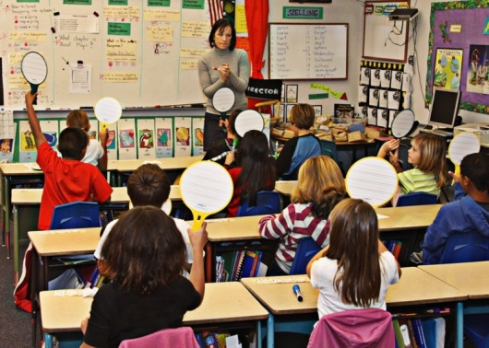
Whole Group instruction is when teachers present a lesson to the whole class with some differentiation in content.
What is Whole Group Instruction?
The purpose of whole class instruction is that all students are presented with a series of learning tasks to allow them to acquire and/or practice their learning. The pace of instruction is such that all students can master it. Learning is assessed as students master skills. (Tier 1 Teaching)
Explicit instruction on reading skills and strategies; collaborative reading of text
Modeled and shared writing; modeling writing skills

Slide 18
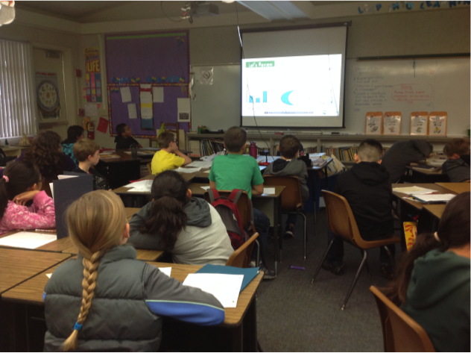
Whole Group Instruction
IS NOT:
The entire 90 minute reading block
Parallel independent work with the teacher supervising
Round robin or popcorn reading
Assessing all day (Friday)
Notes:
Whole group instruction should not be taking place for the entire 90 minute literacy block. A teacher cannot hold the attention of children for that long of a period. Look at the child in the picture. This is what will happen when children are disengaged with the instruction.
Parallel independent work is when the all of the students are engaged in the same activity and the teacher just walks around and supervises or answers questions about the assignment.
Round robin or popcorn reading is not productive for children and can be intimidating. Children loose focus of what they should be comprehending. A better way to do a whole group reading is to choral read, echo or jigsaw.
Assessments do not need to occur only on Fridays. And when they do occur, they should not take an up an entire literacy block.

Slide 19
Whole Group Content
Grade level concepts, skills, and vocabulary
Appropriately complex text
Aligned with the Tennessee Department of Education’s ELA College and Career Ready (CCR) Curriculum Standards
Notes:
During whole group instruction, we should align instruction to the Tennessee ELA CCR Curriculum Standards Strands, specifically and deliberately incorporating Social Studies, Science, and other content through the Reading Standards for Informational Text.
As we teach the content , we need to remember the CCR ELA Standards. They are:
Reading Standards for Literature
Reading Standards for Informational Text
Reading Standards: Foundational Skills
Writing Standards
Speaking and Listening Standards
Language Standards
At K and 1—many of the vocabulary and comprehension skills that students need to master the CCR standards are built through read alouds and discussion. We know that many of our students enter school with limited oral language skills, so we must pay particular attention to oral language in the classroom.

Slide 20
Grouping Configuration
Heterogeneous
ALL students
Second language learners (ESL)
Students with disabilities
Gifted students
Proficient readers and writers
Students needing intervention and/or additional support in reading and writing
Notes:
In whole group instruction, we need to remember that ALL students should be included. The content is grade level, so we need to plan for ways in which we can address the different types of learners that are in our classrooms while still delivering grade level content.

Slide 21
Allocated Time
Approximately 30 minutes
Roughly 1/3 of the designated reading time
Can be broken into one or more segments
Use a small amount of time for closure at the conclusion of each lesson
Notes:
The time requirements are in accordance with the TDOE. The literacy block should be 120 minutes with 90 minutes dedicated to reading instruction, 30 minutes dedicated to writing, and an additional 30 minutes dedicated to reading and writing in content areas. This presentation will focus on the uninterrupted 90 minute reading block.
For this whole group allocated time is approximately 30 minutes;
Saving 5-10 for Whole group closure

Slide 22
Instructional Routines for Whole Group
Systematic and explicit instruction
Teacher states goal, purpose, and expectations
Uses multiple teaching modalities
Follows the “I do, we do” of Gradual Release:
“I do”= Teacher models explicitly teaching/explains content/skills
“We do”= Teacher and students practice together
Checks for understanding and re-teaches as needed
Varies response modalities (visual, verbal, tactile/kinesthetic)
Students practice and apply skills in authentic tasks
Notes:
Our instructional design is based on the gradual release of responsibility model from the work of Doug Fisher and Nancy Frey (2007) and others.
In Whole group, you will only focus on the “I do” and “We do.”
“I do”: The teacher provides direct instruction, establishes goals and purpose, models learning expectations. The teacher varies response modalities to allow for individual differences. For example, an English Language Learner or student with disabilities may not be able to produce a word from memory, but he/she can point to the picture or act out what he/she is trying to say.
“We do”: There is interactive instruction between the students and teacher.
The remainder of the process moves to small group time.
“They do”: The teacher provides groups of students a similar task based on their learning needs. Groups of students work cooperatively and collaboratively to practice and apply the newly learned standard, skill, or strategy. The teacher moves among groups, provides support and scaffolding, and clarifies misunderstandings.
During small group time and whole group closure, the cycle is completed.
“You do”: The teacher provides meaningful, differentiated tasks to individual or small groups of students that are aligned to the standard, skills, strategies. Students practice and apply new learning independently (without the direct support of the teacher). Afterwards, the teacher evaluates and provides feedback.

Slide 23
Reading Minilessons
Focused instruction on a specific topic or skill
Goal: Internalize strategies and become independent readers and thinkers
Topics:
Phonics/Word Study
Comprehension
Vocabulary
Fluency
Notes:
A mini-lesson is a brief lesson (5-10 minutes) that focuses on a specific topic or skill. Note that not all mini-lessons will occur in a single whole group session.
Topic Summary
comprehension is the goal of reading, students must be fluent readers in order to comprehend what they have read. They become fluent by acquiring a certain set of skills that are developmental in nature and linked to each other. Phonemic awareness is the ability to hear, identify, and manipulate sounds in spoken language. Phonics is the understanding that a letter or combination of letters in written language can represent each speech sound. Fluency is the ability of a student to read accurately, at an appropriate rate, and with expression.

Slide 24
Why should we use minilessons in whole group instruction?
Teachers can introduce new concepts or skills to all students
Teachers will use explicit instruction to focus students’ attention on key concepts and skills
Students will be introduced to concepts and skills that they will investigate more thoroughly during small group instruction
Notes:
Emphasize that teachers do not have time during 30 minutes of whole group instruction to teach full lessons on most new concepts and skills. The minilesson allows them to introduce the topic or skill to all students but to go into greater depth during small group time.

Slide 25
Why should we focus on reading foundational skills in whole group instruction?
Teachers can explicitly model sound production, segmentation, and blending (phonemic awareness)
Teachers can explicitly model letter-sound correspondence (phonics)
Students can repeat after the teacher, thus setting up a solid foundation for decoding and fluency
Notes:
Tell participants that many of our students in upper elementary, middle school, and high school lack the foundational skills they need to be fluent readers. Yes, we have phonics activities in stations, but phonics skills must be explicitly taught during whole group instruction.

Slide 26
Why should we engage students in interactive read alouds and shared readings?
Teachers can model fluent reading
Teachers can build on students’ knowledge of vocabulary
Teachers can ask questions that move students to higher levels of understanding
Students can read along during a shared reading in a risk-free environment
Notes:
In an interactive read aloud, the teacher reads aloud and stops periodically to ask questions, build vocabulary, and probe for understanding. During a shared reading, the same processes occur, but all students should have access to the text, either in enlarged (big book) form or by having an individual copy of the text. This allows all students to follow along in the reading and participate in the discussion, even if they are not able to independently read the text.
Notice WHY it is important to engage students in these types of activities.

Slide 27
Minilesson—Whole Group
Whole group activity can take place

Slide 28
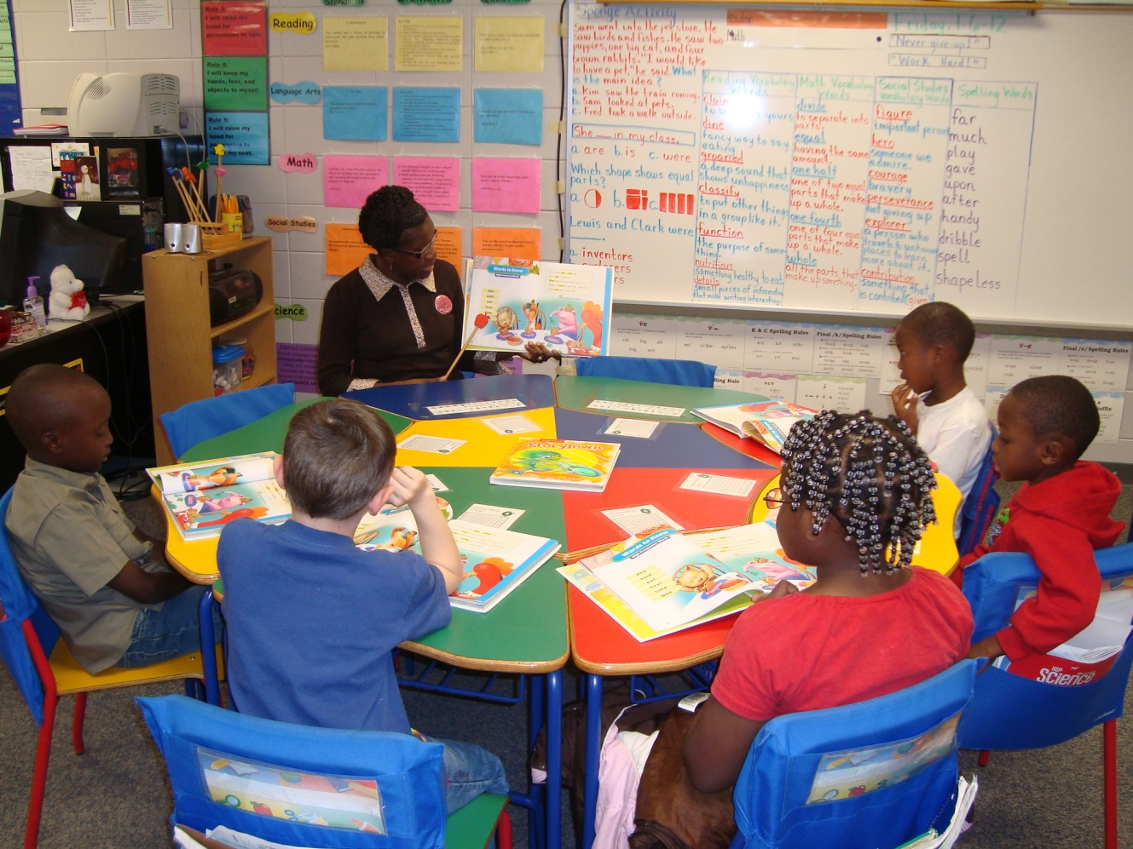
Small Group Instruction

Slide 29
PreK-5 Block and Instructional Design
Required time frame
50 minutes Reading PreK
90 minutes Reading K-3
30 minutes Writing K-3
Grouping structures aligned to purpose
Gradual release of responsibility: “I do, we do, they do, you do”
Students actively involved
 | Reading | ELA/Writing
Core (Grade-Level Instruction for All Students)
Whole Group | Explicit instruction on reading skills and strategies; collaborative reading of text | Modeled and shared writing; modeling writing skills
Small Group | Homogeneous and heterogeneous groupings; practice and apply skills | Independent and group writing; practice and apply skills
Whole Group | Closure and assessment | Closure, assessment, sharing of student work
Notes:
Looking at our instructional design, small groups allow students to practice and apply skills. This gradual release of responsibility falls under the “they do” and “you do.”

Slide 30
Small Group Instruction
Small group instruction typically refers to a teacher working with a small group of students on a specific learning objective. These groups consists of 2-6 students, and provide these students with a reduced student-teacher ratio. Small group instruction usually follows whole group instruction. It allows teachers to work more closely with each student, reinforce skills learned in the whole group instruction, and check for student understanding.
Notes:
Small group instruction is for specific learning objectives. Groups can consist of 2-6 students and they provide smaller teacher/student ratio. It is to reinforce skills, and check for understanding.

Slide 31
Purpose of Small Group Instruction
To allow the teacher the opportunity to teach/re-teach skills needed by specific groups of students
To allow the teacher the opportunity to assess students in a small group setting
To provide corrective feedback, as necessary
.
Notes:
Read slide—this is the purpose of small group instruction.

Slide 32
Why are Literacy Stations required during Reading instruction?
To provide clear objectives from whole class linked to small group instruction
Opportunities to practice and refine skills that have been taught in whole group; NOT “busy work”
Differentiated activities within each station, based on the needs of the students
To ensure concurrent teacher-directed small group instruction; each child goes to 2-3 stations
Notes:
Read this slide
Small group skills based lessons often focus on a phonics skill or decoding strategy. After a teacher teaches the skill explicitly, he/she should guide the students through reading of decodable text that allows them to apply the new skill

Slide 33
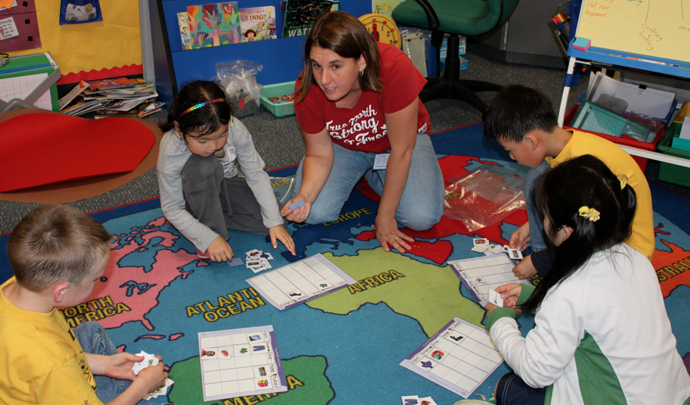
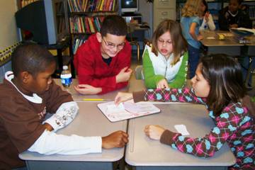
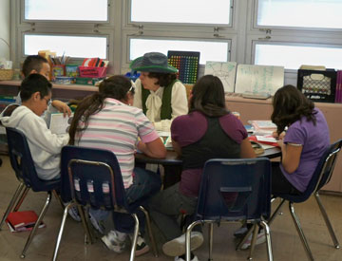
Small group instruction should be…
45-60 minutes daily
2-3 rotations
Peer to peer small groups
Literacy stations
Teacher directed guided reading or skills based instruction

Slide 34
45-60 minutes daily
2 to 3 rotations
Teacher directed small group reading
Literacy stations
Peer to peer small groups
Small group instruction should be…
Notes:
K-3:
Teach/re-teach skills to those who need it: informal “on the fly” assessment
Usually homogeneous grouping
15-20 minutes per group; concurrent with literacy stations/ peer-to-peer groups
Non-negotiable: must occur every day

Slide 35
Grouping Configuration
Usually homogeneous, although some groups may be interest-based or topic-based
OR
Heterogeneous with ALL students
English Language Learners (ELL)
Students with disabilities
Gifted students
Proficient readers and writers
Students needing intervention and/or additional support in reading and writing

Slide 36
Instructional Routines for Small Groups
Explicit, differentiated instruction
Uses multiple teaching modalities
Follows the “They Do and You Do” of Gradual Release:
- “They do”= Students are paired or grouped to practice.
- “You do”= Students practice and apply the new learning independently.
Checks for understanding and re-teaches as needed
Circulates/Monitor
Students practice and apply skills in authentic tasks learned in whole group
Notes:
Gradual release of responsibility…..from the work of Doug Fisher and Nancy Frey (2007)
Small Group
“They do”: The teacher provides groups of students a similar task. Groups of students work cooperatively and collaboratively to practice and apply the newly learned standard, skill, or strategy. The teacher moves among groups, provides support and scaffolding, and clarifies misunderstandings.

Slide 37
Before implementation of Literacy Stations, model, practice and review what to do when:
Something does not work
They do not understand the activity at a center
They complete the activity
Whom to go to for help
How to clean up
How to decide who goes first in a pair or group activity
How to take a restroom break
Notes:
Refer to what had been discussed earlier in the presentation—the chart that was made with their responses.
Ask if them if the literacy stations are something that will be expected the first week of school.
No—they are placed on the curriculum map to be introduced the 4th week for kindergarten. Principals have been told that routines and procedures and introductions to literacy stations must be in place before stations begin. In grades 1-5, by the third week of school, stations should be occuring.

Slide 38
Transition into Small Groups K-1
How to transition from whole group to small group:
Use a bell with designated rings (model)
Use hand gestures/signals (model)
Use verbal cues/phrases (model)
Use table colors/group names
Use numbers/signs/arrows/chart
Organize stations around the perimeter of the room for rotations
*Be CONSISTENT with all techniques
Notes:
Presenter may add other ways to transition from whole to small group.
Ask the audience to share a few ways that they have used transitions between station work.

Slide 39
http://www.schooltube.com/video/5d078ba7ca6b36d8a671/Differentiated%20Instruction:%20Developing%20different%20types%20of%20workstations

Slide 40
Beyond Appearances
It’s not about how students are arranged; it’s about the work in which they are engaged.
Is instruction-- -Purposeful -Rigorous -Differentiated to meet student needs -Consistent with evidence-based practice -Aligned to TEM standards
Notes:
Ask questions
Note that stations are not always physical spaces. Due to the size of a classroom, types of furniture, and teacher preferences, materials may rotate rather than students. It is important that the work within the stations changes and that the work is matched to the capabilities of the students within each group.
It is okay if the student’s do not physically move between rotations, but their work should change.
Ask teachers if any one rotates without moving the students and how it works for them.

Slide 41
Small Group
Add 1-2 activities to have participants do in a small group

Slide 42
Whole Group Closure in Reading
When: the last 5-10 minutes
Why: to bring synthesis and closure to the lesson; to share student understandings and provide the teacher with a quick assessment
Suggested activities
Exit tickets
Written summary
Tell a partner
Poll the class/individual responses
Notes:
After concluding the rotations, it is important to have the children reassemble into a whole group to bring closure to the lesson. Various strategies can be used depending upon the grade level that is taught.

Slide 43
Whole Group Closure
Share some techniques that you use to bring closure to your lessons and to check for understanding.
Notes:
Presenter can ask for various ways the teachers bring closure to their lessons and chart them.

Slide 44
Closure
Three Stars and a Wish—on your index card list
3 “stars” (things you plan to implement within the next two weeks)
1 “wish” (something you want us to address in future sessions)
Notes:
Now that we have gone through the process of the 90 minute literacy block, we are going to have closure for our session.
Read the slide.
Have the teachers/participants do the activity and then have them share out one thing they can implement immediately.

Slide 45
Literacy Staff
Dr. Susan Dold, DOLDSB@scsk12.org
Dr. Tanya Kelly, KELLYTL@scsk12.org
Jolie Madihalli, MADIHALLIJA@scsk12.org
Visit us on our weebly:
www.scsliteracy.weebly.com
Password: readandwrite

