Slide 1
Do Now
Show What You Know Game Show
Select an index card from the table
On one side, write the word TRUE
On the other side, write the word FALSE
Notes:
Time: 3 minutes
Encourage the participants to begin the “Do Now” as soon as they enter the room. After 3 minutes, check to see if everyone has created their card for participation in the game show activity.

Slide 2
Show What You Know About RTI
Game Show
Notes:
Time: Less than 1 Minute
Read the slide in the voice of a game show host. The goal is to involve the participants in the presentation.

Slide 3
RTI² stands for Response to Instruction and Intervention.
Notes:
Time:2 minutes
Display the question. Have the participants hold up their response.
-Click the button to display the correct answer.

Slide 4
The goal of the RTI process is to identify students with special, cognitive, needs.
Notes:
Time:2 minutes
Display the question. Have the participants hold up their response.
-Click the button to display the correct answer.
Ensure the participants understand the goal of RTI is NOT to identify students for special education services. The goal is to ensure that all students receive explicit instruction and targeted intervention support to perform at or above grade level.

Slide 5
A student in Tier II should receive a minimum of 225 minutes of intervention each week.
Notes:
Time:2 minutes
Display the question. Have the participants hold up their response.
-Click the button to display the correct answer.
-Inform the participants that this statement is false because Tier II instruction should last for 30 minutes each day totaling 150 minutes each week.
-The content of the slide is true for Tier III because those students will receive 45 minutes of intervention each day, totaling 225 minutes each week.

Slide 6
The CLIP process is a part of
Tier I Instruction.
Notes:
Time:2 minutes
Display the question. Have the participants hold up their response.
-Click the button to display the correct answer.

Slide 7
Response to Instruction and Intervention (RTI²): Ensuring Children get the Targeted Support they Need For Success
RTI²
September 18, 2015
Notes:
Time: 2 minutes
Say, “I know that many of us are familiar with the acronym RTI2 and have developed mixed emotions, understandings, and experiences with the process. For some, today’s session will serve as an affirmation of what you already know and for others the information my seem new or conflict with your original thoughts. Either way, I hope that you all are willing to keep an open mind as we reset/recalibrate our collective understanding of the RTI2 process as a staff/school. We will need to remember that our ultimate goal is to ensure that the individualized needs or our students are addressed.”

Slide 8
KUDo’s
Know the goals, priorities and strategies of Destination 2025 and how the Response to Instruction and Intervention (RTI²) framework supports the work
Understand how RTI² can be leveraged to support progress towards district, school, and student specific improvement goals
Be able to Do
  Explain the RTI² pyramid for tiered support and the expectations (e.g., time, focus, data) for core/Tier 1 and Tier 2 intervention associated with each grade band
  Identify individual students, by name and need, that qualify to receive additional instruction through the RTI² process
  Leverage RTI² resources, documents and trainings
  Establish school-based expectations, teams, and procedures for implementation fidelity and accountability to ensure students get the support they need
Notes:
Time: 1 minute
Read the objectives for the session to the group. Make sure you emphasize what the participants will be able to do at the end of the training.
Say: “At your table, you have some session notes to help guide your thinking and reflection through this afternoon.”

Slide 9
Norms
Be present and engaged
Be respectful
Monitor “air time”
Stay focused on students
Honor the trust- Ideas are being shared for feedback and improvement, not for sharing outside the group
Notes:
Time: 1 minutes
Have the participants take a moment to read the norms silently. Remind them that today’s presentation will be technology free meaning that they should not have their computers or cell phones out during the presentation. Remind the participants that we want to make sure that we disagree respectfully and keep the best interests of the students at the center of our work today.

Slide 10

Annotate the Case Example
Silently, read the text to yourself.
Underline the major points.
Use a question mark (?) for keywords or phrases that are confusing or unknown to you or questions that you have during the reading. Be sure to write your question(s).
Use an exclamation mark (!) for things that surprise you, and briefly note what it was that caught your attention.
Draw an arrow when you make a connection to something inside the text, or to an idea or experience outside the text. Briefly note your connections.
Circle specific words that resonate with you and your understanding of the RTI² framework and process. (Think about specific steps or tools.)
Notes:
Among materials for the session, tables should have copies of the Mr. Amante’s Class and RTI² case study.
Say: “You have copies at your tables of an imaginary teacher/classroom case study. I know it looks long, but it’s a quick read and its ok for you to skim it. While skimming, annotate the text using the ‘rules’ here. As we begin to build our our own annotation muscles with students, it makes sense to have standard sets of rules each class, if not schoolwide. Then as readers develop their skills and ownership of the process, freedom to develop and use their own rules should be provided Of course, each text might require some customization of the ‘rules’ based on the purpose for reading and the readers’ focus. With that in mind, we’ve added the last bullet, asking you to circle words or phrases that match our understanding or experience with RTI2 in SCS. Please also notice that the expectation around adding question marks also asks you to write down your questions in the margins, and when/if you find the answer in the text, to go back and write those. Good readers do this intuitively, without actually annotating, but it’s an important skill for us to model and reinforce with our students.”
“Now, please take about 5-7 minutes to read and annotate the text.” (Walk around the room taking notes on some of the most common annotations—so you’ll know which ideas most resonated or troubled them; it becomes a formative assessment to help you guide the conversation and know where you need to go deeper, to clear up confusion. As you walk around, encourage folks to write down their specific questions, comment on a few exclamation points, etc.)
Note, you will not discuss the case immediately. Hold off the discussion until a few slides ahead.
Provide a 1-minute warning, allowing individuals who have already finished to discuss the case and their annotations with their group. Encourage them to focus in on their surprises and questions, and see if their colleagues can’t help clarify some of their questions.

Slide 11
RTI²
An instructional framework based on a problem-solving model for addressing individual student needs (TN Department of Education, 2015)
An approach built on the premise that high-quality INSTRUCTION and INTERVENTIONS, are guided by student performance data
A process of improving educational outcomes for ALL students, while meeting the state department requirements related to the Individuals with Disabilities Education Act (IDEA) and the Elementary and Secondary Education Act (ESEA).
Notes:
Time: 4 minutes
Before you show all the slide content/bullets (animation), “Now let’s come back from the case, we’ll go back to that in more detail in a minute, but for now, can you share out a few big ah-has, big ideas that you marked with an exclamation point. As your colleagues share out, if you hear something that also resonated with you, would you please snap your fingers.” (Take 3-5 share outs, encouraging snaps as appropriate, and keeping all engaged. You do not need to comment on each response, you’re mostly trying to see what stood out for them to see what they know and help lead into the content on the slide.)
Then show the bullets.
“So you’ve captured many of these big ideas. Throughout this discussion and across the District and the State, you’re going to hear us refer to RTI2 (emphasizing the squared). But this is not just a SCS or even TNDoE initiative. It’s a nationally recognized approach to improving student learning, often referred to simply as RTI—Response to Intervention, with only one “I”. In SCS and the State, there is a deliberate focus on good first teaching, hence the “response to instruction AND intervention INCLUDES the two ‘I’s, or I squared. Regardless of the name though, the basic tenets and the research base are the same. “
Review the bullet points.
Emphasize the fact that RTI² is an instructional framework that is designed to provide all students with an opportunity to learn.
Tell the participants that the RTI² process involves providing customized supports for students that may need to the identification of students who have a Specific Learning Disability and need special identification services to be be successful. However, it is not exclusively for the purposes of identifying students for special education services—though to do so, implementation, including careful progress monitoring and record keeping, has to be complete.

Slide 12
Purpose of RTI²
Promises that all children have access to high quality instruction and that struggling and accelerated learners, including those already identified as being eligible for special education (i.e., students with IEP’s), are identified, supported, and served early and effectively.
RTI² implementation, with fidelity, results in:
more reliable and detailed student progress data,
more effective instruction,
more strategic use of limited resources (e.g., intervention programs, instructional time and staff),
increased student achievement,
more appropriate identification of Specific Learning Disabilities (SLD),
increased professional collaboration, and
overall school improvement.
Response to Instruction and Intervention is not a program. It is more than a checklist to be completed or data points to obtain. It is truly a means for ensuring that student growth and success occurs on a daily basis.
Notes:
Time: 2 minutes
-Read the slide to the participants.
-Tell the group to focus in on the green box and reread the statement.
-Inform the group that in our district we serve a large number of students, who do NOT have learning disabilities; however, they are currently under performing academically. If we leverage our RTI2 effectively, we will provide instruction to those students that is intentional, explicit, and targeted towards improving the individual performances.

Slide 13
3 Tier model
What are the academic supports for each RTI² Tier Level?
Notes:
Time: 5 minutes
“Reflecting now on what you read in the case study, can you identify some of the key components of RTI2 and the work at each tier? As you look back at your annotations, what were some of the tools and practices that you circled?”
Have participants share out, probing and prompting for some of the following:
-good core instruction
-universal screening
-targeted support
-on-going progress monitoring
(If they struggle, ask specific questions that push them back into the text, e.g., “If you look back at Mr. Amante, what did it say about his daily instruction?” (Prompt for the core text, pacing guides, grade-level/standards-aligned work) “What did it say about how he and his colleagues worked together?” “What data did they have on all students?” “What resources and strategies did they have to support struggling students? How did they know if their strategies were or were not working?” Depending on time and debate, ask them to point out where in the text they got each answer from.)
Say:“Wow, you really teased out a lot of big ideas.”

Slide 14
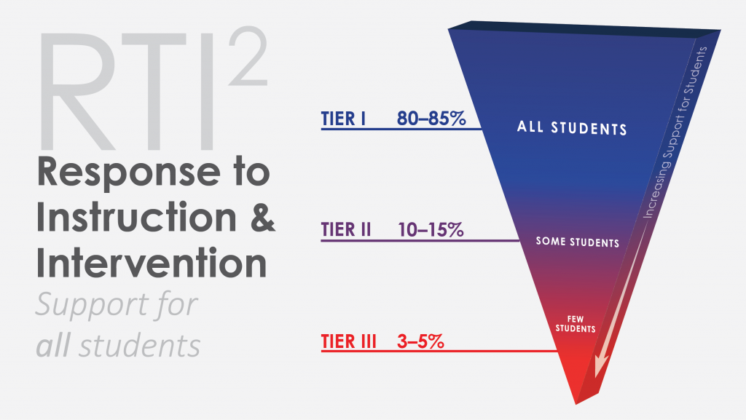
Notes:
Time: 5 minutes
-Tell the participants that you would like for them to take a minute of private think time to reflect over the graphic.
-After the minute has elapsed, allow the participants to turn and talk to discuss if they believe that the graphic is reflective of our school district.
-After two minutes, bring the group back together and allow one or two people to discuss their opinions about the graphic.
*The goal of this slide is to ensure that the participants understand that Core Instruction (Tier I) should address the cognitive needs of 80 to 85% of the students in a classroom setting; therefore, what we do in Tier I determines the amount of intervention (Tier II or Tier III) services that our students will need to receive.

Slide 15
Response to Intervention (RtI2)
Standard RtI2
Tier 3:
Individualized
Strategies
(e.g., replacement curriculum)
Tier 2: Effective, Strategic Supplemental, Interventions and
Progress Monitoring (e.g., I-Station for K-8 Reading)
1-5%
SCS Students by Literacy Performance
5-15%
43.9%
80-90%
Tier I: Research Based,
Core Programs,
Universal Screening
Grade-level instruction aligned to grade-level (CCSS) standards, curriculum maps and pacing guides, district-adopted instructional materials (e.g., HMH-Journeys for K-5 and resources)
22.7%
33.4%
Notes:
“Unfortunately, as this slide shows, student performance in SCS does not follow this national distribution. We could argue about why, but what matters now is that the majority of our classrooms currently reflect an inverted pyramid. In order to invert the achievement distribution, we will have to enhance the quality of our Tier I instruction. That’s why we’ve been talking about shifting, as a district, from incremental to more transformative—bigger, faster progress for all students—particularly in literacy and mathematics. So far, our work on the CLIP, as most of you discussed this morning, has been focused on Tier 1, on-grade-level, core instruction—including what we teach and how.”
Click for the next animation of the RTI2 overview.
“The training you have had so far and CLIP look fors are meant to be applied now, during Tier I instruction.”

Slide 16
Attributes of
Literacy Instruction for Tier I
Explicit Instruction
Required Time Lengths
Different Grouping Configurations
Grade Level Content
All students participate in the instructional block
Notes:
Time: 4 minutes
-Read the slide to the participants and discuss each bullet in detail.
-Remind the participants that with our CLIP model, explicit instruction is a requirement. The gradual release model should be used to provide students with direct instruction prior to requiring them to engage in independent learning activities.
-All elementary students are required to participate in a 90 minute literacy block each day. Middle and high school students are required to participate in core blocks that range from 50 to 60 minutes each day. Remind the participants that within that 90 minute block 20 to 25 minutes should be spent on whole group instruction, 60 minutes on small group instruction, and 5 to 10 minutes should be spent on closure each day.
-During the literacy block, students should be engaged in activities that involve whole group, small groups, partners, and individual participation.
-****Stress the fact that Tier I instruction should be on the students grade level. Teachers should incorporate the use of the Journey’s resources and materials during this time.
-The final reminder is that ALL students are expected to participate in the literacy block.
“I’ve laid this out through the literacy lens, but the general idea is also true for mathematics. We should see explicit, on-grade level instruction to the standards, as well as flexible groups, and gradual release in Tier 1 math classrooms and across content areas. And differentiation still occurs.”

Slide 17
RTI² Implementation
All Students:
Receive explicit, on-grade-level instruction (Tier 1)
  associated with foundational literacy and numeracy skills
  incorporating gradual release model
  differentiated as appropriate
  per grade-specific, requisite instructional minutes
Complete the universal screening assessment (3 x a year)
As needed, receive targeted, supplemental academic supports to successfully complete tasks to achieve to grade-level standards (Tier 2 and 3)
  requisite instructional minutes
  on-going progress monitoring (with approved metrics and consistent record keeping)
Notes:
Time: 2 minutes
RTI² Inform the participants that students are our centralized focus for the the RTI2 process. Review the slide.
-Read the common components from the slide. “Many of these you described earlier as you reflected on your annotations.”

Slide 18
RTI² Implementation
Teachers, coaches, counselors, etc.:
Participate in school and district teams
Administer universal screener
Analyze universal screening data to focus and continuously improve Tier I instruction and help identify students for Tier 2 instruction and intervention
Maintain and analyze Tier 2 and 3 progress monitoring data to continuously improve Tier 2 and instruction and intervention
Monitor and practice implementation fidelity, across tiers
Support parental involvement, including communicating re: student goals and progress
Engage in professional development based on professional learning and student development needs

Slide 19
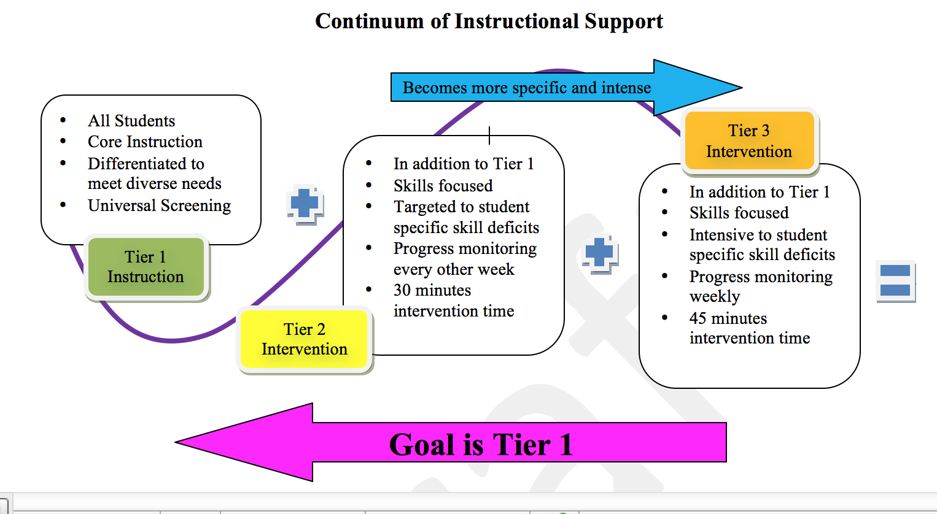
Notes:
Time: 2 minutes
-Ask the group to take a moment to reflect upon the graphic.
-Tell them that the goal of RTI is to ensure that all students receive high quality core instruction.
-Tell them that now we will take a closer look at the expectations associated with each Tier—what it looks like in process.
Don’t go into a lot of detail… each Tier is discussed in upcoming slides.
“Take a quick look at the questions you had in your annotations about Tier 1. Does anyone want to share a question they had?” (You don’t need to answer these, just get a sense of them so you can make sure to address them in the upcoming slides.)

Slide 20

Universal Screening
NWEA’s Measures of Academic Progress (MAP)
K-12, online, adaptive assessment
  Reading/language arts, mathematics, and science
  Same assessment for benchmark assessments and universal screeners (per RTI²)
TNCore and TNReady aligned, in content and format
  Provides reports based on standards and skills, as well as proficiency
  Supports development of flexible student groups (Tier 1 differentiated instruction)
  Links to instructional resources, based on student needs
Administered electronically, 3 x a year
  Easy for teachers and students
  Allows us to measure progress over time
Nationally recognized, widely used assessment
  Allows us to set student, class, school, and district-specific growth targets based on like students
Notes:
Note: this slide is hidden until the Board approves the 2015-16 Universal Screener, expected 9/10/15
Begin the following before the bullets/in animation
“Let me say more about the universal screener--
“Even when teachers do the most effective job possible teaching reading, some students will still not respond to instruction. For this reason, it is important to figure out which students are struggling. To do this, schools begin the year by doing a universal screening of all students using a short assessment of grade-appropriate reading skills—and repeat this two more times during the year to continue to screen students for additional support.
“The schools then identify students who are at risk for reading or math (and sometimes behavioral) difficulty based on their level, relative to grade level expectations. The schools then monitor progress of these students in intervention.”
“We analyze the universal screener data to see which students may need more assistance than with our core reading or math curriculum. The District can use either local or national norms/performance levels to determine if students are “at-risk.” (http://www.studentprogress.org/library/CaseStudy/reading_grade4_comprehension_3-4-09.pdf)
“As k-8 staff experienced last year, in addition to the State assessments, we also had to administer both the Discovery Ed Assessment as our benchmark assessment AND Istation and then Iready screeners. And we were still short a progress monitoring tool to help us track the effectiveness of our interventions… and there was not screener or progress monitoring for high school. That was a lot of testing, a lot of data, and still very little specific information about the actual needs of our students that we could use in instruction.
“The District actually heard our concerns and went out to bid this year, for a more streamlined assessment system. We now have one single, on-line assessment that serves both to provide benchmark information against the standards and screen students for additional support.”
Click and review the bullets

Slide 21
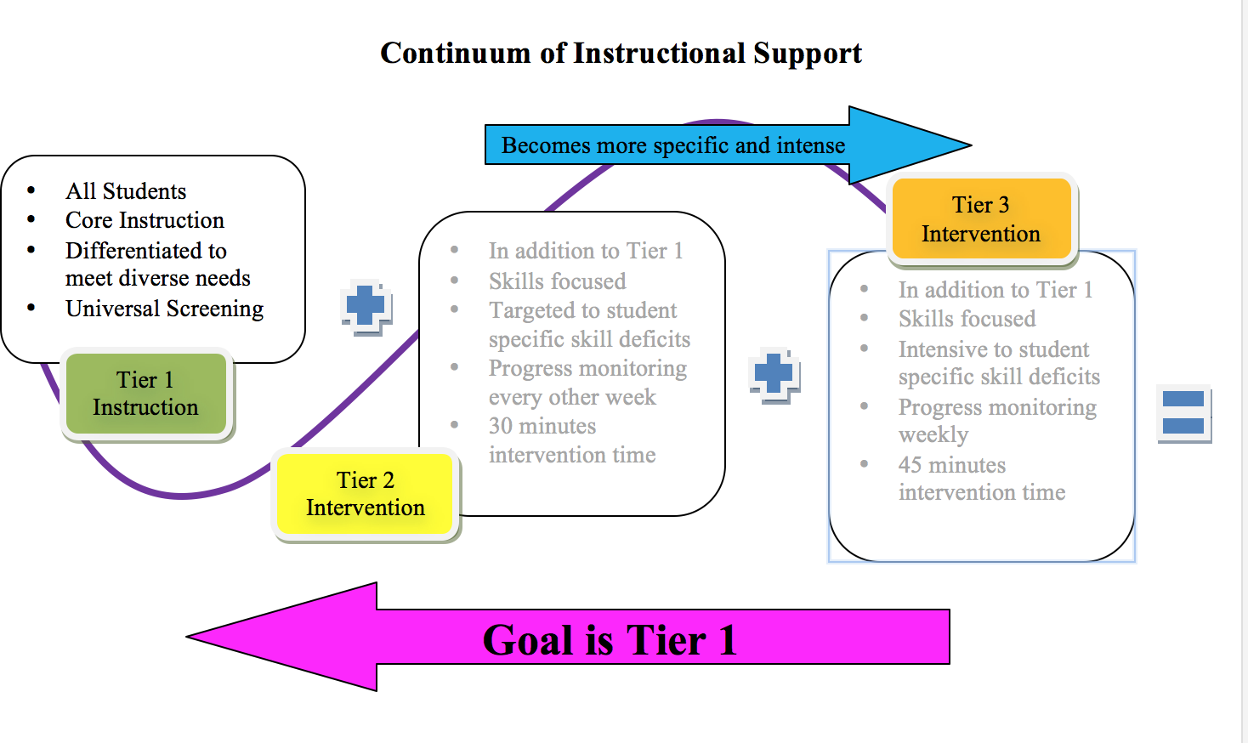
Tier 1- A Closer Look
Notes:
Time: 3 minutes
The Tier II and Tier III slides are intentionally gray. The focus here is the Tier 1 instructional block.
-Restate the key aspects associated with Tier I by reading the bullet points to the group. Emphasize points that came up in their questions.
“At Tier 1, we need to ensure all students have access to core, grade-level instruction aligned to the state standards for college and career readiness (TNCore). I know we’re tempted, mostly in our efforts to support our struggling students, to go easy, but we can’t support our students by simply giving them easier, below level work. We need to provide scaffolds through —both in our whole group instruction, which is why we see the emphasis on modeling and gradual release, and in our small groups. “
“Like all good teaching, we need ongoing assessment of student learning—against grade level benchmarks—so we can see progress to the standards.”
“Use of Universal Screener, K-12.. This is a shift. Last year we only screened K-8, but we know we need to identify and provide targeted supports to our struggling high schoolers as well. That’s why the District recommended and the Board just approved a new, K-12 benchmark assessment/universal screener for all schools and students.
“Collect data points, determine patterns, track individual and groups performance and use these to guide instruction (teach/assess/monitor/adjust)… which is different than trying to teach to the test.”
“And we need to ensure we’re implementing with fidelity (Team, Student Data, etc.)”
*ESL students may be pulled from the block, if they are not intermediate readers, by their ESL teachers. The instruction from the ESL teacher counts as core instruction. Additional guidance for this topic will be included in the District RTI2 Manual.

Slide 22
Fidelity of Implementation: SCS Expectations for Tier I Instructional Minutes
English/Language Arts
Math
K-2
150 minutes
* 90 minutes of uninterrupted reading block
3-5
90 minutes
6-12
55 minute traditional block
K-2
60 minute block for K/1
75 minute block for 2nd Grade
3-5
90 minutes
6-12
55 minute traditional block
Notes:
Time: 2 minutes
This slide displays the instructional times for ELA and Math instruction for all K-12 students—based on all the CLIP and other PD, what fidelity means should be clear by now.
-Inform the group that math in grades 3-5 must last a minimum of 60 minutes but the state’s recommendation is that math lasts for 90 minutes, and many schools are already implementing to that level.
-Make sure that the group understands that as a school/district, we currently meet or exceed the required instructional frameworks for literacy and math.

Slide 23
Fidelity of Implementation: Not Permissible in Tier I
Intervention or use of on-line intervention programs is NOT provided during core instruction (to ensure all students have access to good first teaching to grade-level standards)
Interventions must be delivered to students outside of the dedicated literacy or math block of core instruction
Notes:
Time: 2 minutes
This slide is imperative to ensure that teachers understand that programs designated for intervention should not be used during the reading block for any reason. Istation and Iready are both intervention programs and students should only use them during the intervention block.
(Note: Inform the group that data generated from the intervention programs can and should be used to make instructional decisions for establishing skill based instructional and intervention groups. Both intervention programs, like the universal screener and benchmark assessment, create reports that identify skill deficiencies for students. Tell them a screen shot of the I-station report is on the next slide.)

Slide 24
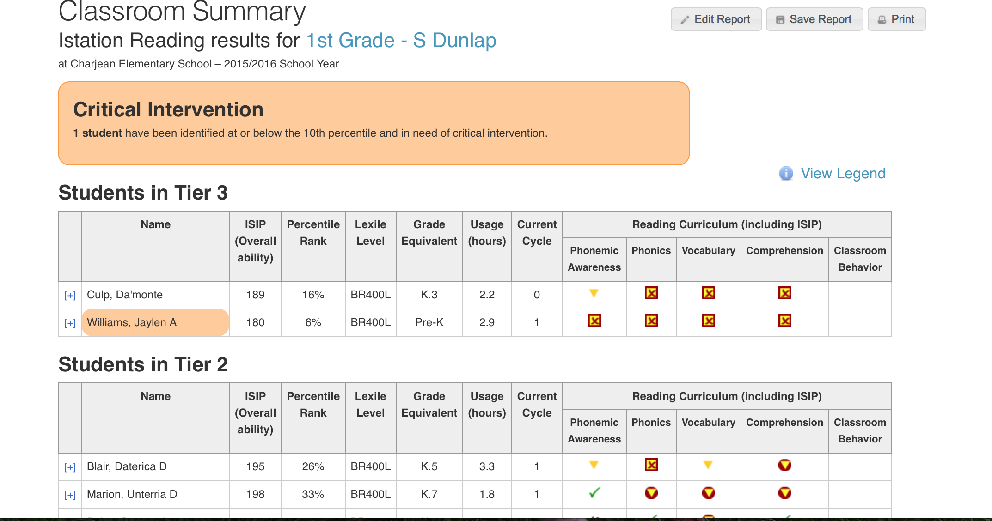
I-Station Classroom Summary Report
Notes:
Time: 2 minutes
-Explain to the group that the I-station Classroom Summary is an example of an intervention report that can be used to group students. The report places the students into groups according to their tier levels.
(Note: That small groups should not contain more than 5 students.)
“Note, this is a screen shot for one of the online interventions for K-8, but the District is also in the process of selecting additional on-line interventions and credit recovery programs for use in high schools. More information is forthcoming. The good news is, we’ll finally have something to help our most struggling high school students in reading and math.

Slide 25
Pair Share: Why Tier II?
Select a partner to work with for discussion.
Decide who will be partner A and who will be partner B.
Partner B will begin the discussion (1 minute to speak) as A listens.
Partner A will continue the discussion (1 minute to speak) as B listens
Both will develop a statement to justify the need for Tier II instruction within the school.
Notes:
Optional Slide/activity, based on time
Time: 4 minutes
Guide the participants through a pair/share activity. Have them select a partner and decide who will be partner A and partner B.
-Set a timer for 1 minute and repeat the process 2 times to guide participants through the activity.
-Allow two to three pairs to share their justification statement.
Conclude the discussion by stating that “Tier II is important because it provides students with an opportunity to receive targeted instruction focused on foundational skills, with the goal of helping the students increase their capacity in literacy and math.”

Slide 26
Tier II Intervention Overview
Universal Screener used to identify students for Tier II support
Students performing within the 24th-10th percentile ranks on the universal screener receive Tier II instruction
Tier II instruction should consist of high quality evidence-based interventions, in specific areas of deficit (standards protocol, problem solving, or hybrid of the two)
Tier II students receive instruction through teacher-led, face-to face and/or computer based
Notes:
Time: 5 minutes
Before clicking the bullets.
“Going back to your annotations, what questions did you have about Tier 2 intervention? What ah-ha’s? Who can describe what Tier II looked like in our hypothetical JCPS and for Mr. Amate’s students?” Quick share out, citing the text as needed.
Select participants from the audience to read the bullet points.
Ensure that participants understand that Tier levels are determined through the standards based universal screener.
Also highlight that the small group ratio for Tier II instruction is 5 students per adult.
To be clear, the secondary/Tier 2 intervention is part of general education. It is an evidenced-based response to the specific student need(s) and can include supplemental support from reading/math specialists, classroom teachers (in addition to the regular classroom/Tier 1 instruction), and/or assisted by technology, with online programs like Istation and Iready for K-8. The District is currently in the process of identifying/approving some on-line Tier 2 reading and math interventions for high school and is expecting to take options to the Board in the coming weeks.

Slide 27
Fidelity of Implementation:
Tier II Intervention
Use of a standards-based universal screener to identify Tier 2 students and basic skill area of deficit for targeted support
Additional 30 minutes of explicit instruction daily
  Evidence-based, targeted instruction
  Taught by highly trained personnel
  Student to teacher ratios of 5:1
Regular monitoring of fidelity of implementation (FOI) of intervention (3 times a marking period, at least 2 direct observations)
Student progress monitoring (every other in area of deficit)
Data team meetings (every 4 to 4.5 weeks)
  Review Progress
  Calculate Rate of Improvement
  Discuss interventions
  Determine need for changes in intervention
Notes:
Time: 5 minutes
Option to review or have audience member read the bullet points.
Make sure that the participants understand that Tier II students should receive an additional 30 minutes of instruction each day and they should undergo progress monitoring every other week.
Strongly emphasize the point that Tier II instruction should be based on a foundational skill deficit (phonemic awareness, phonics, fluency, comprehension, vocabulary, numeracy, computation, etc.)
FOI monitoring for Tier II should occur a minimum of 3 times within a 9 weeks period. At least of the the monitoring visits should be in the form of a direct observation.

Slide 28
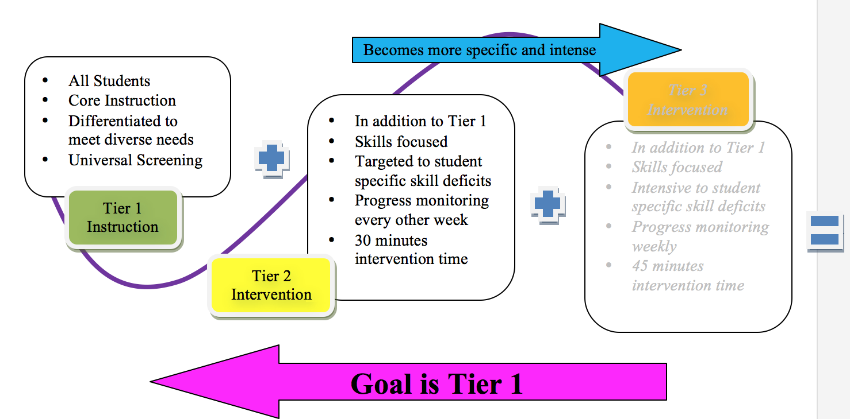
Tier 2- A Closer Look
Notes:
Time: 3 minutes
-Use a pointer to focus on the plus sign in the graphic. Tell the participants that Tier II students should receive high-quality Tier I instruction plus Tier II instruction.
-Ensure that participants understand that K-5 students who are in Tier II for ELA should receive 120 minutes of ELA instruction each day.

Slide 29
Fidelity of Implementation: SCS Expectations for Tier II Instructional Minutes
English/Language Arts and Math (each)
K-2
30 additional minutes each day
3-5
30 additional minutes each day
6-12
30 additional minutes each day
Notes:
Time: Less than 1 minute
Emphasize that all Tier II students should receive 30 minutes of instruction each day.
Note that the state recommends 20 minutes for Kindergarten and first grade; however, to ensure that intervention is delivered with fidelity and that all students complete a cycle on I-station, all Tier III students will receive a minimum of 30 minutes of intervention each day.
Say, “As a reminder, the law requires that all schools have Tier II instructional time built into the schedules for all students each day. At this school, Tier II intervention is embedded in the following way:_______________ Facilitators will need to consult with the leadership at their individual schools to inform the participants of how Tier II is scheduled at the location.

Slide 30

Progress Monitoring
easyCBM by Riverside Publishing (a division of Houghton Mifflin Harcourt)
Assesses reading/language arts and mathematics
  Includes foundational skills
  Calculates rate of improvement
Can be administered in a group, online format except for the early grades reading fluency measures.
Can be used K-12
Links to our HMH Journeys reading instructional resources
Notes:
Slide is hidden until Board approval, expected 9/10/15 of new progress monitoring assessment.
“As with all effective instruction, Tier 2 support includes on-going assessment of student learning and mid-course adjustments, as needed. In RTI2, schools monitor progress of students who are at-risk and receiving targeted, supplemental support (still in general education). This includes more frequent assessment and formal tracking of the data—to understand both how students are progressing and the extent to which the specific intervention/approach is working (or if another approach is needed).”
“As I mentioned earlier, the District heard our concerns about the amount of time spent on assessment and the amount of work progress monitoring of Tier 2 demands of teachers. We all know this is important work and we want to be involved in getting to know the needs of our students and how they are growing, but given the frequency of progress monitoring needed for Tier 2, we needed some support.

Slide 31
Tier II Intervention Overview
Tier II instruction should consist of high quality evidence-based interventions in specific areas or deficits (standards protocol, problem solving, or hybrid of the two)
Notes:
Time: 5 minutes
Before clicking the bullets.
“Going back to your annotations, what questions did you have about Tier 2 intervention? What ah-ha’s? Who can describe what Tier II looked like in our hypothetical JCPS and for Mr. Amate’s students?” Quick share out, citing the text as needed.
Select participants from the audience to read the bullet points.
Ensure that participants understand that Tier levels are determined though the standards based universal screener.
Also highlight that the small group ratio for Tier II instruction is 5 students per adult.
To be clear, the secondary/Tier 2 intervention is part of general education. It is an evidenced based response to the specific student need(s) and can include supplemental support from reading/math specialists, classroom teachers (in addition to the regular classroom/Tier 1 instruction), and/or assisted by technology, with online programs like Istation and Iready for K-8. The District is currently in the process of identifying/approving some on-line Tier 2 reading and math interventions for high school and is expecting to take options to the Board in the coming weeks.

Slide 32
Tier III Overview
Universal Screener used to identify students for Tier III support
Students performing within the 9th-1st percentile rank on the universal screener receive Tier III instruction
Tier III instruction should consist of high quality evidence-based interventions in specific areas of deficit (standards protocol, problem solving, or hybrid of the two)
Tier III students receive instruction through teacher-led, face-to face and/or computer based
Notes:
Time: 5 minutes
Select participants from the audience to read the bullet points.
Ensure that participants understand that Tier levels are determined through the standards based universal screener.
Also highlight that the small group ratio for Tier II instruction is 3 students per adult.

Slide 33
Fidelity of Implementation:
Tier III Intervention
Use of a standards-based universal screener to identify Tier III students and basic skill area of deficit for targeted support
Additional 45-60 minutes of explicit instruction daily
  Evidence-based, targeted instruction
  Taught by highly trained personnel
  Student to teacher ratio of 3:1
Regular monitoring of fidelity of implementation (FOI) of intervention (5 times a marking period, at least 3 direct observations, 2 of which must be a review of implementation data, e.g., student attendance, lesson plans, progress monitoring results)
Student progress monitoring (Weekly in area of deficit)
Data team meetings (every 4 to 4.5 weeks)
  Review Progress
  Calculate Rate of Improvement
  Discuss interventions
  Determine need for changes in intervention
Notes:
Time: 2.5 minutes
Select participants from the audience to read the bullet points.
Make sure that the participants understand that Tier III students should receive an additional 45-60 minutes of instruction each day and they should undergo progress monitoring weekly.
Strongly emphasize the point that Tier III instruction should be based on a foundational skill deficit (phonemic awareness, phonics, fluency, comprehension, vocabulary, numeracy, computation, etc.)
FOI monitoring for Tier III should occur a minimum of 5 times within a 9 weeks period. At least of the the monitoring visits should be in the form of a direct observation.
“We’ve now seen this phrase ‘Fidelity of implementation’ a couple of times. What do you think it means?”
(prompt to get to “fidelity, like in a marriage, is about faithfulness, in this case to the model or design. I know in the past we’ve sometimes gotten by just being able to check items off a list and say we did it, but whether we’re talking about the CLIP Look Fors or RTI2 accountability, we need to be clear, these are not yes or no items. How we implement, how faithful we are to the research and best practice principles really matters… and that’s what we’ll be held accountable for……. We have to ask the question, did we really implement deeply, with fidelity, in ways that supported student learning”

Slide 34
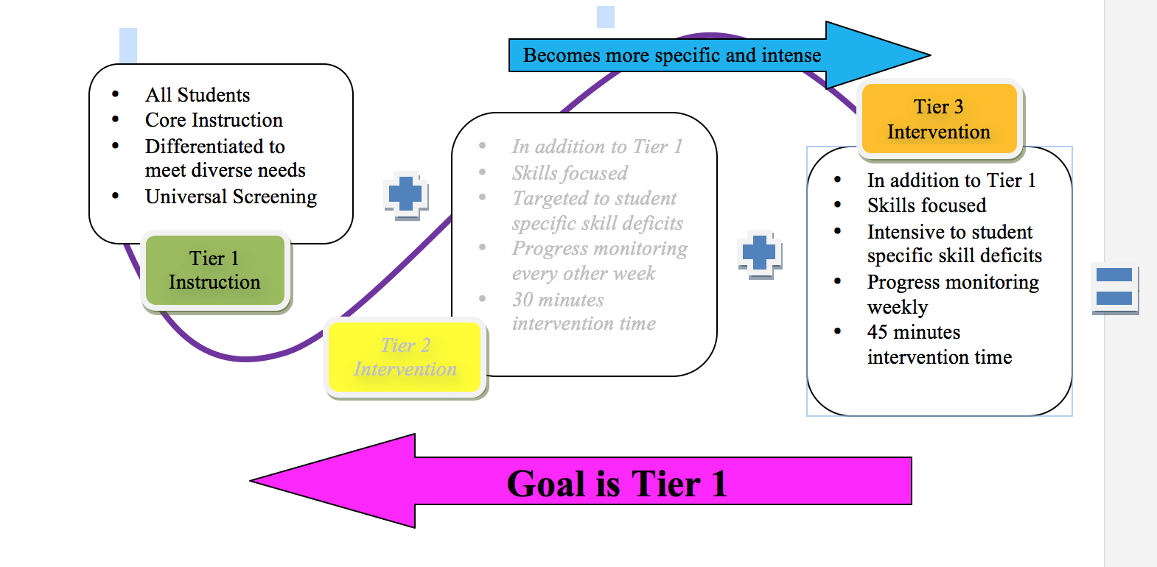
Tier 3- A Closer Look
Notes:
Time: 3 minutes
-Use a pointer to focus on the plus sign in the graphic. Tell the participants that Tier III students should receive high-quality Tier I instruction plus Tier III instruction.
-Ensure that participants understand that students who are in Tier III for ELA should receive a minimum of 135 minutes of ELA instruction each day,

Slide 35
Fidelity of Implementation: SCS Expectations for Tier III Instructional Minutes
English/Language Arts and Math (each)
K-2
45-60 additional minutes each day
3-5
45-60 additional minutes each day
6-12
45-60 additional minutes each day
Notes:
Time: Less than 1 minute
Emphasize that all Tier III students should receive between 45 and 60 minutes of instruction each day.

Slide 36
Sample Intervention Block
45 minute allotted block
Teacher directed Group
Tier II-30 min.
Tier III- 45 minutes
Computer based Individualized Group
Tier II-30 min.
Tier III- 45 minutes
Enrichment Station
Activities for students who do not need Tier II or Tier III Interventions
Notes:
Time: 2 minutes
Explain that the graphic above provides a pictorial representation of the different activities that should be taking place during an intervention block.
-Essentially, the classroom should reflect a three ring circus during intervention time. This means students are working independently on intervention or enrichment activities and a small group of students are working with the teacher.

Slide 37
RTI² in SCS
How will RTI² look like at our school?
Notes:
Time: 1 minute
“We started by looking at RTI2 implementation in the imaginary JCPS and Mr. Amate’s classroom. We have also spent some time talking about it in SCS. The next section of the presentation will focus on what we can and are expected to do to ensure students get the targeted support they need, and we implement RTI2 with fidelity to support ALL students. As I suggested, the District is in the process of rolling out the Universal Screener and Progress Monitoring tools, as well as, some potential additional interventions. We won’t go into detail on any of these today, but I will leave you with a few resources.
Our focus is primarily on understanding the larger purpose and process to ensure fidelity and better support for all of our students.

Slide 38
Fidelity of Implementation:
Specific Expectations for School Sites
School level administrators/instructional leadership teams ensure instructional minutes are explicitly scheduled and met
  Tier I instructional minutes (req’d for all grade levels; must simultaneously ensure State and Board req’d minutes for all core content areas)
  Tier II and III instructional minutes (req’d for all K-8 grades; strongly recommended for HS in 2015-16; req’d for all grade levels in 2016-17)
Schools adhere to time-lines for administering universal screener and progress monitoring assessments
  Ensure staff are trained and technology scheduled, as appropriate
Each school develops a data team (may leverage an existing team, but must provide explicit attention to RTI² implementation)
  Ensure frequency of meetings and regular review of data, including timely identification of students for targeted (Tier II and III) support
  Ensure identified students receive support (aligned to improvement goals/needs), progress monitored and recorded, and adjustments made as appropriate
School level administrators will develop a school based protocol for conducting fidelity checks (additional resources/training available)
Notes:
Time: 5 minutes
Review each bullet point.
Are data teams and student review (SR) teams the same?
“The data team is responsible for conducting meetings to monitor the progress of all Tier II and Tier III students who are involved in the RTI2 process. When conducted with fidelity, this is the only pathway that a student can be identified as having a specific learning disability to receive special education services. Not all Tier 2 or Tier 3 students will be SpEd identified; however, no one can be excluded from this process. I know sometimes we get anxious with our school psychologists because but our psychologists are held to these same criteria… we have to be sure that the student is NOT responsive to intervention first, and we have to be able to show that. And by the way, sometimes even our best experience and expertise is wrong. The process helps us and the students.”
-Also emphasize that the data team only deals with academic factors, though we encourage schools to think about developing a similar process to support students who may need more significant behavioral interventions. (the State is heading in that direction, but is not yet requiring it.)
-The student review team can be formed, on an as needed basis, to develop an action plan and brainstorm solutions for students with other disabilities and behavioral issues. **It is important to note, that students who are going through the student review process should participate in RTI2 as well if an academic issue is suspected.

Slide 39
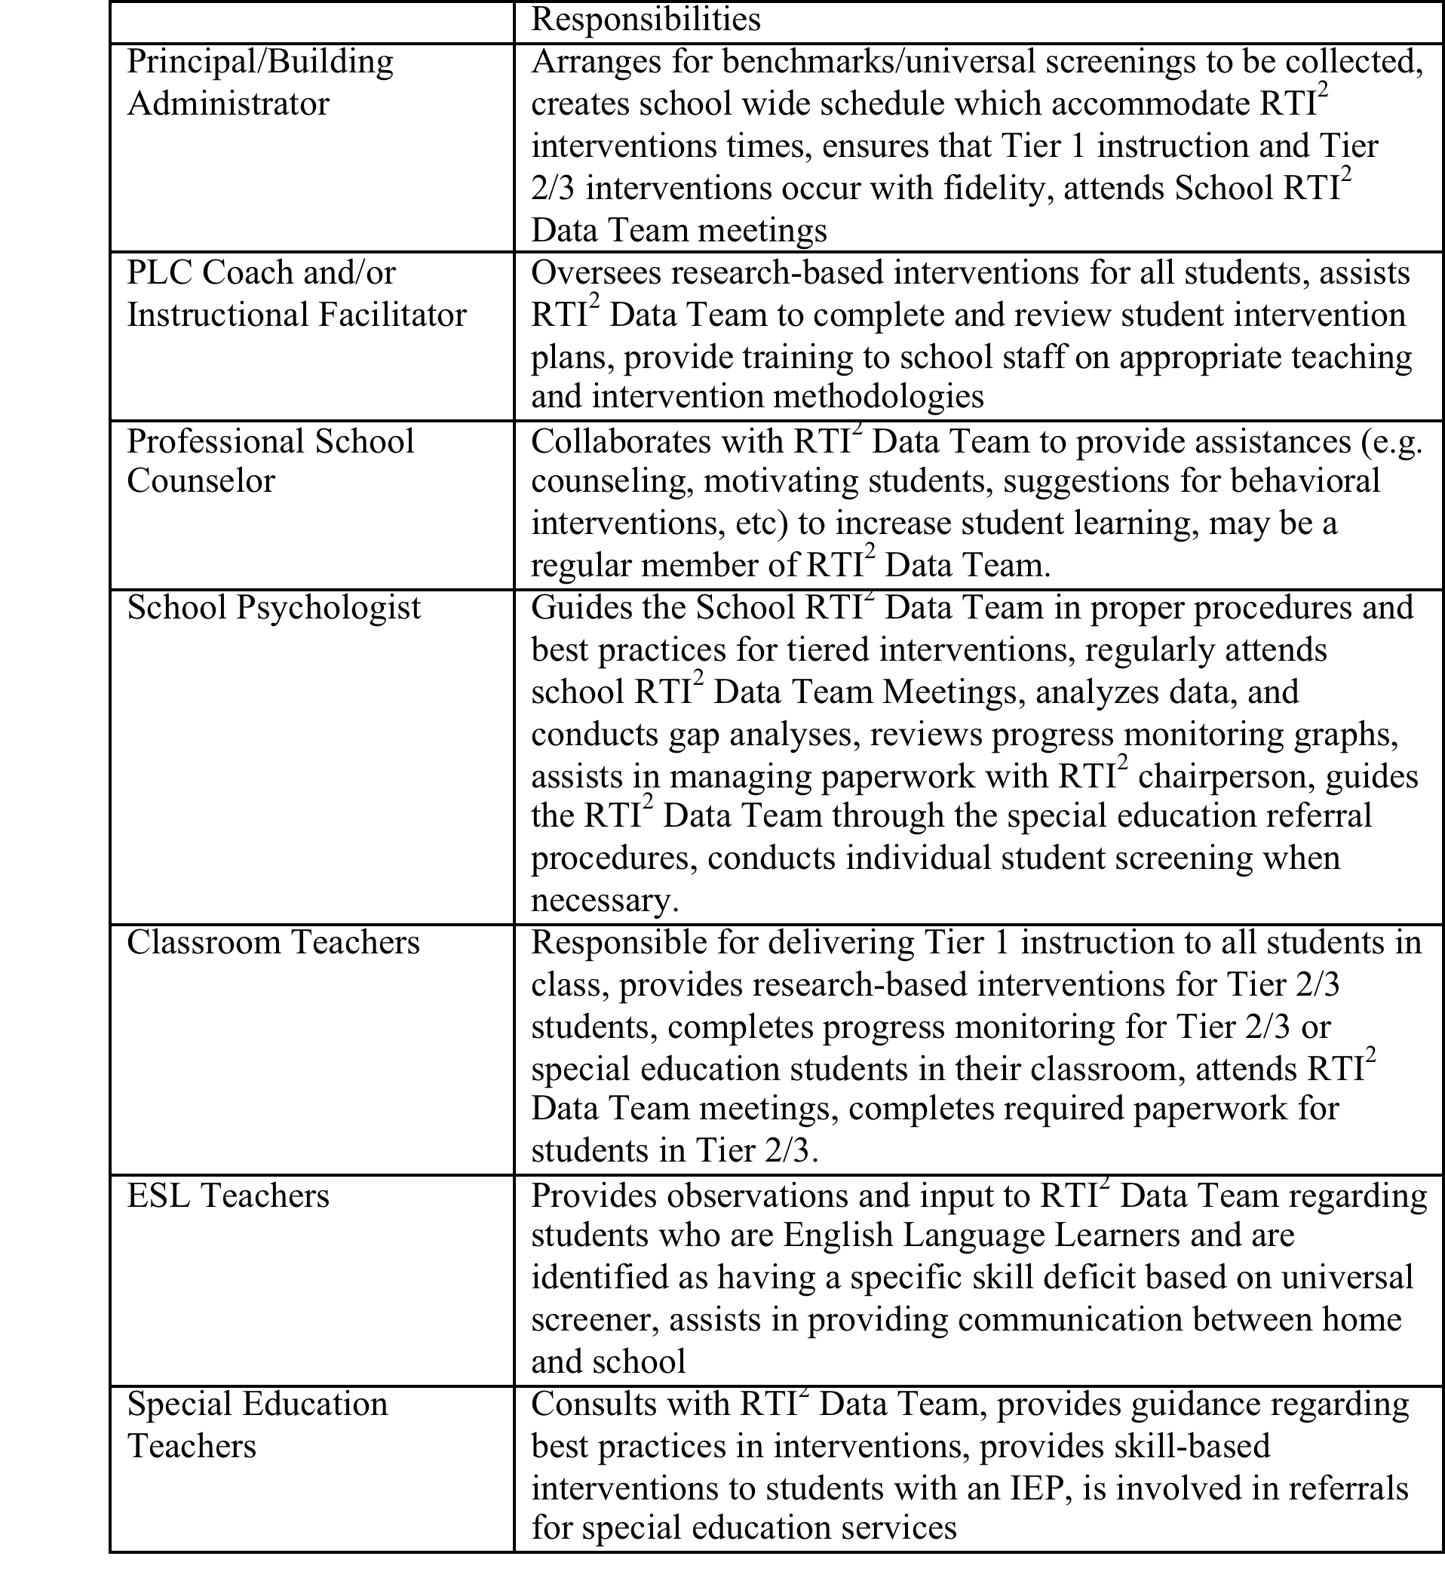
RTI² Implementation Responsibilities and
Data Team Composition
Notes:
Time: 3 minutes
“Take a minute to find yourself in the first column and review your role on the RTI2 data team. (Wait a minute for each to be ready. ) When I call out your group, please stand and read aloud, together, your responsibilities. Please remain standing.”
When all groups have stood and finished reading the table, give them a round of applause. “You have both survived the training and committed yourselves and [insert school name] to ensuring that we implement the CLIP and RTI2 with fidelity, and that in doing so, we will ensure that every [School name[ student gets the support he or she needs to be successful!”
“You may sit down.”

Slide 40
Questions???????
Notes:
Time: 1 to 2 minutes
“Let’s go back to your annotations one more time. In your group, look at the questions you wrote down. Hopefully, you’ve been writing down answers as we went through the session today. What questions do you still have? Can you answer them as a group? Take a minute to discuss.”
Walk around the room quickly, informally collecting the remaining big questions. (if you have time, you can have them call these out.) When you bring them back, answer the ones you can and take note of the big ones you can’t today, but that you’ll follow up on.

Slide 41
KUDo’s
Know the goals, priorities and strategies of Destination 2025 and how the Response to Instruction and Intervention (RTI²) framework supports the work
Understand how RTI² can be leveraged to support progress towards district, school, and student specific improvement goals
Be able to Do
  Explain the RTI² pyramid for tiered support and the expectations (e.g., time, focus, data) for core/Tier 1 and Tier 2 intervention associated with each grade band
  Identify individual students, by name and need, that qualify to receive additional instruction through the RTI² process
  Leverage RTI² resources, documents and trainings
  Establish school-based expectations, teams, and procedures for implementation fidelity and accountability to ensure students get the support they need
Notes:
Time: 1 minute
Remind them of the goals for the session, but also, “We know this was a lot to take in during a long day… It’s ok if we still have some questions and are still learning. The important thing is to remember that we’re all still learning and that if we push and lean on each other, we can continue to improve our individual and schoolwide practice, and better support our students. We can do this!”

Slide 42
Reflection
Return to your session notes:
  Which part of the presentation most resonated with you and why?
  Which key points should serve as our guide as we continue this work? In pairs or triads, identify one “take away” phrase for SCS.
What additional resources and/or training do you need to be successful?
What feedback can you provide on topics discussed in this meeting? (Help us reflect on our own continuous improvement.)
Notes:
Time: 3 minutes
Allow the participants time to reflect over the session. Depending on time, you might not ask participants to consider all three now, Do make sure they share out, either out loud or on post-its, what they need to be successful.
Collect the sticky notes or index cards from the participants as they leave the session.

Slide 43
next steps and activities for follow up

Slide 44
Next Steps and Follow-up Section
Visit the TN Department of Education Website. Download the materials and resources that you will use to implement RTI² in your school building.
http://tncore.org/sites/www/Uploads/RTI_templates/RTI2_Manual_revision_1_15%20final.pdf
Download the RTI² District Implementation Guide from the Shelby County School’s Website (Coming Soon).
Notes:
Time: 1 minute
Inform the participants where they can find additional resources and information about the RTI process.

