Slide 1
Making Sense of Math Learning Progressions Middle School
District Learning Day
Friday, September 18, 2015
Notes:
Total Time for Presentation: 141 minutes
Time: 1 minute
Materials needed: Handouts
Say: “Most of our colleagues are in literacy PD today, and we all understand that the CLIP work is important district wide—across grades, content areas, and schools. But we also know that the new standards require major shifts for students, teachers, coaches, and leaders in math as well—and that we still have a long way to go to get all of our students to math proficiency and true college and career readiness.

Slide 2
Do Now
How would you summarize the major work of your grade/course?
What would you have expected to be a part of the major work that is not?
Notes:
Time: 5 minutes
Say: Let’s take a few minutes and engage in a discussion around the major work of the grade. Have participants share out with the group.
Working with a few colleagues at your table, walk through the emphases for your grade/course and reflect on the question that is here.
How would you summarize the major work?

Slide 3
Norms
Be present and engaged
Be respectful of differences in perspective while challenging each other productively and respectively
Monitor “air time”
Make the most of the time we have
Stay focused on students
Notes:
Time: 1 minute
Say: Let’s take just a moment to review the norms for our session today. In order for us to get the most from our time today it is imperative that we focus on the work at hand. In order to do this we must put distracts aside and refrain from multitasking during our session. We may encounter some differing views during our our work today and that is okay. We need to be able to treat our differences with respect and challenge each other so that our work can contribute to the success of our students. Let’s stay focused on our students, and make the most of our time together.

Slide 4
Agenda
Objectives
Destination 2025
Mathematical Teaching Practices and Shifts
Activity – Math Shifts (Focus)
Break
Learning Progressions
Activity – Math Shifts ( Coherence)
Next Steps
Notes:
Time: 1 minute
Say: Let’s take a moment to review our agenda for the day. We have a lot to cover in just a short amount of time so let’s get started.

Slide 5
Objectives
The Participants will
Know
mathematical teaching practices that promote effective mathematics instruction and deepen understanding of mathematics concepts and procedures.
how mathematical shifts guide instruction through learning progressions
Understand
connection between the major work of the grade and the learning progressions so that teachers can engage in focused effective planning utilizing curricula resources
Do
• determine the major focus of each grade so that teachers can make connections from Kindergarten through Algebra II
collaborate with peers to complete the instructional alignment chart on the provided strand
Notes:
Time: 2 minutes
Say: In August we learned how to find the TN State Standards and how they are embedded in our District Curriculum Maps. Our objectives for today are:
The Participants will
Know
mathematical teaching practices that promote effective mathematics instruction and deepen understanding of mathematics concepts and procedures.
how mathematical shifts guide instruction through learning progressions
Understand
connection between the major work of the grade and the learning progressions so that teachers can engage in focused effective planning utilizing curricula resources
Do
determine the major focus of each grade so that teachers can make connections from Kindergarten through Algebra II collaborate with peers to complete the instructional alignment chart on the provided strand

Slide 6
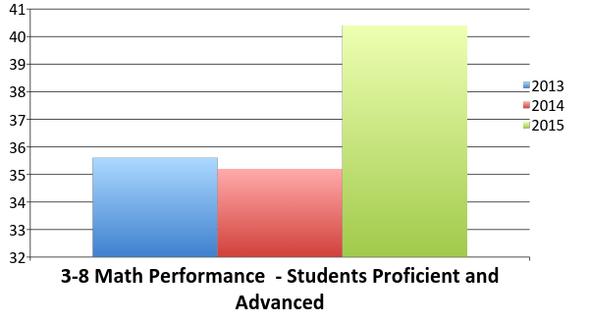
Student Performance Data
Notes:
Time: 2 minute
(Teachers have not seen this)
Say: Let’s take just a few minutes to celebrate our accomplishments this past year. As you can tell from this graph we have a lot to be proud of. There has been significant growth in our 3-8 Math students.
While there has been significant growth, less than 50% of our students are proficient in Math. In fact the data shows that only 40% of our students are proficient in grades 3-8 Mathematics. In order to meet our goals we need to grow our students so that 80% are proficient by 2025. If we break that down – our target of P/A students for 2016 will be 42%.
.

Slide 7
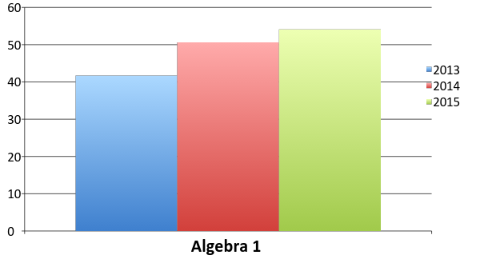
Student Performance Data
Notes:
Time: 1 minute
Say: Let’s take just a few minutes to celebrate our accomplishments this past year. As you can tell from this graph we have a lot to be proud of. There has been continuous growth in our Algebra 1 students.
While there has been significant growth we still have a long way to go to reach our 80% goal.

Slide 8
80% of our students will graduate from high school college or career ready
90% of students will graduate on time
100% of our students who graduate college or career ready will enroll in a post-secondary opportunity
Notes:
Time: 2-3 minute
Say: While we have much to celebrate we must keep our eyes on our District’s Goal: Destination 2025. Take a minute to remind ourselves of that goal and to think about what we need to do to accomplish this goal. Share your thoughts with your partner.
Facilitator will then share information from 2-3 groups.

Slide 9
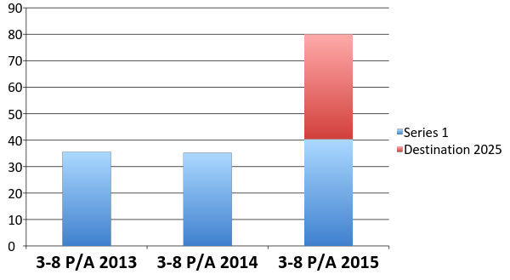
Current Reality
Notes:
Time: 1 minute
Say: It’s now time to look at our current reality. Less than 50% of our students are proficient in Math. In fact the data shows that only 40% of our students are proficient in grades 3-8 Mathematics. In order to meet our goals we need to grow our students so that 80% are proficient by 2025. If we break that down – our target of P/A students for 2016 will be 42%.

Slide 10
Notes:
Time: 1 minute
Say: You may be wondering, just how are we going to get there. It must first start with building capacity within our teachers. You are the single most important driver of student success. Therefore, the district is making it a priority to develop teachers to drive student success. Today we will begin by looking at a deep understanding of the mathematical content embedded in the TN State Standards.

Slide 11
MATHEMATICS TEACHING PRACTICES AND SHIFTS
Notes:
Time – 2 -3 minutes
Say: At August DLD we took an in-depth look at the instructional maps and highlighted the standards, major work of the grade, and resources that teachers can use to help implement effective teaching practices and plan rigorous lessons to help students master grade-level/course content.

Slide 12
Effective Mathematics Teaching Practices
Establish mathematics goals to focus learning
Implement tasks that promote reasoning and problem solving
Use and connect mathematical representations
Facilitate meaningful mathematical discourse
Pose purposeful questions
Build procedural fluency from conceptual understanding
Support productive struggle in learning mathematics
Elicit and use evidence of student thinking
Notes:
Time: 10 minutes
Materials needed: Effective Mathematics Teaching Practices handout
Say: “ Effective teaching is the non-negotiable core that ensures that all students learn mathematics at high levels.” Principles to Actions – NCTM
Say:
The effective Mathematics teaching practices are as follows:
Establish mathematics goals to focus learning
Implement tasks that promote reasoning and problem solving
Use and connect mathematical representations
Facilitate meaningful mathematical discourse
Pose purposeful questions
Build procedural fluency from conceptual understanding
Support productive struggle in learning mathematics
Elicit and use evidence of student thinking
Say: While all of these practices are essential today we are going to focus on the first practice: establish mathematics goals to focus learning. Effective teachers of mathematics establish clear goals for mathematics that students are learning, situates goals within learning progressions, and uses the goals to guide instructional decisions. Please note that the teaching practices are different from the math practice standards.
“This research informed framework of teaching and learning reflects the knowledge that has accumulated over the last two decades. It represents what we see as a core set of practices and essential teaching skills necessary to promote deep learning of mathematics” – NCTM – Principles to Actions
Facilitator: You may want make a connection between these practices and the TEM rubric. Let teachers talk about the math practices and what they might look like. However, the main focus for today is on the first practice: Establish mathematics goals to focus learning

Slide 13
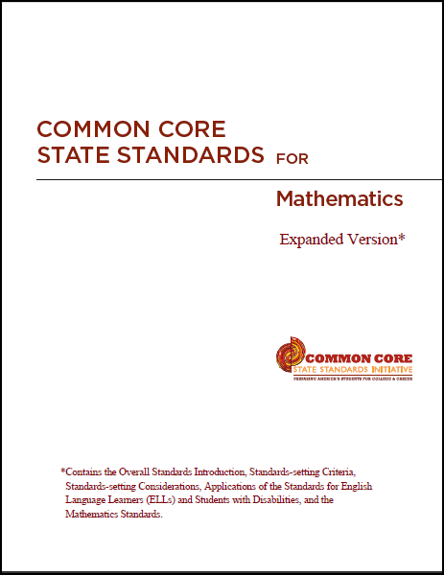
Mathematics Standards
Shifts
In:
Mathematical Practice
Mathematics Content
For:
Grades K-8
first three HS courses (Algebra 1, Geometry, Algebra 2, and Core Math 1, 2, and 3), and
in 2014, new standards for the further HS math courses
Focus strongly where the standards focus
Coherence: Think across grades, and link to major topics within grades
Rigor: In major topics, pursue conceptual understanding, procedural skill and fluency, and application
Notes:
Time: 2 min
Only 26% of college professors think that their kids are prepped for college-level math while 89% of high school teachers report they are prepped. In addition, our curriculum has been incoherent when compared to other countries
Say:
Focus Shift: Significantly narrow the scope of content and deepen how time and energy is spent in the math classroom. Focus deeply on what is emphasized in the standards, so that students gain strong foundations. Move away from "mile wide, inch deep" curricula identified in TIMSS and learn from international comparisons. Less topic coverage can be associated with higher scores on those topics covered because students have more time to master the content that is taught.
Coherence Shift: think across grades, and link to major topics within grades
Thinking across grades: The Standards are designed around coherent progressions from grade to grade. Principals and teachers carefully connect the learning across grades so that students can build new understanding onto foundations built in previous years. Teachers can begin to count on deep conceptual understanding of core content and build on it. Each standard is not a new event, but an extension of previous learning.
Linking to major topics: Instead of allowing additional or supporting topics to detract from the focus of the grade, these topics can serve the grade level focus. For example, instead of data displays as an end in themselves, they support grade-level word problems.
Rigor Shift: in major topics pursue conceptual understanding, procedural skill and fluency, and application with equal intensity
Conceptual understanding: The Standards call for conceptual understanding of key concepts, such as place value and ratios. Teachers support students’ ability to access concepts from a number of perspectives so that students are able to see math as more than a set of mnemonics or discrete procedures.
Procedural skill and fluency: The Standards call for speed and accuracy in calculation. Teachers structure class time and/or homework time for students to practice core functions such as single-digit multiplication so that students have access to more complex concepts and procedures.
Application: The Standards call for students to use math flexibly for applications. Teachers provide opportunities for students to apply math in context. Teachers in content areas outside of math, particularly science, ensure that students are using math to make meaning of and access content.
As we begin our work today, we are going to spend time looking at focus and coherence and discuss how student work looks across grades, as well as within the major work of the grade.

Slide 14
Focus on the Major Work of the Grade
Two levels of focus:
What’s in/What’s out
The shape of the content that is in
Notes:
Time 2 min
Facilitator note: You may ask the following question to start the discussion: “How would your teaching be affected if no standards were identified as the major work of the grade/course?
Say:
There are two levels of focus.
The first level is the focus of what is in versus what is out; what is being taught at each grade level compared to what is not. It is because of this level of focus that teachers will have the time to go deeper with the math that is most important. Compared to the typical state standards of the past (which in some cases were literally volumes of standards that would have taken years to “cover,” even one grade’s worth of math), the Common Core State Standards for Mathematics have fewer standards which are manageable and it is clear what is expected of the teachers and students at each grade level. That is the 1st level of focus.
The other level of focus is the shape of the content that is in each grade or course. What that means is that if you look at the “focused” list, say for Kindergarten, you can see the list in terms of shades. There are things that are really sharp and focused in the middle, that are the major content for that grade. The other topics are there in a supporting way and help to support that major work. So, even within the list that exists, there is focus. That is the 2nd level of focus.

Slide 15
Focus Activity
Engaging with the shift: What do you think belongs in the major work of each grade?
In your groups, discuss ways you could respond if someone asks you the following questions, “Why focus? There’s so much much math that students could be learning. Why limit them?”
You will examine three topics for grades Kindergarten through Algebra 2 and determine which two of the three given topics are major areas of focus for that grade or course.
Review the table given and answer the question “Which of the following represent areas of major focus for the indicated grade?”
Note: the topic that is not the major work of that grade is also not a topic required by the Standards at all for that grade.
Notes:
Time: 20 min (5 min group talk about “Why Focus” and “Why limit them” questions ; 10 min to discuss findings from focus activity; 5 min share out )
Materials: Practicing with the Shifts Handout
Say: You are now going to participate in an activity to identify the major work of each grade Kindergarten through Algebra 2. Engaging with the shift: What do you think belongs in the major work of each grade? You will examine three topics for grades Kindergarten through Algebra 2 and determine which two of the three given topics are major areas of focus for that grade or course. Review the table given and answer the question “Which of the following represent areas of major focus for the indicated grade?”
Facilitator note:
It is encouraged that you attempt this activity first without consulting the Standards or Focus by Grade Level documents to allow for thoughtful engagement and discussion.

Slide 16
Answer Key
Notes:
Time 10 min for slides 16-19
Say:
Take just a moment to compare the answers in the activity with the answer key provided. Discuss how the highlighted areas of focus build from grade to grade. Review the unhighlighted items and briefly discuss why the topic does not belong with the other two topics.

Slide 17
Answer Key
Notes:
Continued from previous slide

Slide 18
Answer Key
Notes:
Continued from previous slide

Slide 19
Answer Key
Notes:
Continued from previous slide

Slide 20
Break Time
10 minute Break
Notes:
Time: 10 minutes
Say: You will now take a 10 minute break.

Slide 21
Coherence Across and Within Grades
It’s about math making sense.
The power and elegance of math comes out through carefully laid progressions and connections within grades.
Notes:
Time: 2 min
Say: Coherence is about math making sense.
Just like there are two levels of focus, there are two types of coherence found in the math standards. One is the coherence of topics across grades and the other is the coherence within a grade.
You will see coherence across grades as the Standards direct us to have students apply learning from a previous grade to learn a new topic. Then you will see coherence within a grade/course in the Standards as they direct us to have students reinforce a major topic by utilizing a supporting topic.

Slide 22
Understanding and Using the Instructional Alignment Chart
Step 1: Standards for grade/course
Step 2: Changes
Step 3: Levels of Instruction
Step 4: Implications for Instruction and Assessment
Notes:
Time: 10 min
Materials needed:
Understanding and Using the Instructional Alignment Chart Handout
Instructional Alignment Chart Model Handout
Instructional Alignment Chart Template Handout
Pass out the handout titled Understanding and Using the Instructional Alignment Chart.
Say: The information on this handout provides a structure for professional collaborative conversations about the TN State Standards and how they inform teacher decision making. The four steps outlined above correspond to the four sections of the Instructional Alignment Chart that you will complete in a few minutes. This collaborative conversation and the accompanying tool capture important findings for the conversation and can help guide and focus teams of teachers and instructional leaders as they study the standards.
The facilitator will read information under each step or call on participants to read the information as well.

Slide 23
Instructional Alignment Chart
Review the model instructional alignment chart
Highlight common language in the standard
Describe the changes in terms of content and processes
Analyze the changes document to determine the appropriate level(s) of instruction
Identify instructional and assessment approaches in the model example
Notes:
Time: 20 min
Pass out the handout titled Instructional Alignment Chart. (The chart that is completely filled in)
Facilitator will read the information on the slide. In groups, have participants review the model, highlight common language and discuss the other components in the alignment. You may need to explain that the changes from grade 3 to 4 are listed in the first “changes” box and the changes from grade 4 to 5 are listed in the second “changes” box.

Slide 24
Activity – Coherence Learning Progressions
Group work
Take the following strand and complete the Instructional Alignment Chart:
Grade: 7.NS.A – Apply and extend previous understandings of operations with fractions to add, subtract, multiply, and divide rational numbers.
Notes:
Time: 20-30 min
Pass out the handout titled Instructional Alignment Chart with the 6,7, and 8th grade standards filled in at the top.
Facilitator note:
Have participants complete the chart and discuss their answers with a partner and then share out with whole group. There are no right or wrong responses. This exercise should generate rich discussions about how important it is for teachers to make sure to deliver instruction, for their grade, that helps students make sense of what they are learning and build conceptual understanding. If not, that will affect the outcomes for the next grade. In addition, it is important to know what students learned in the previous grade and how the standards in the current grade tie in to the next grade level.

Slide 25
Reflection
What new information did you learn from the alignment activity?
How will this information guide your future practice?
Notes:
Time: 5 minutes
Say: What new information did you learn from the alignment activity? How will this information guide your future practice?
Have participants share with their group.

Slide 26
Objectives
The Participants will
Know
mathematical teaching practices that promote effective mathematics instruction and deepen understanding of mathematics concepts and procedures.
how mathematical shifts guide instruction through learning progressions
Understand
connection between the major work of the grade and the learning progressions so that teachers can engage in focused effective planning utilizing curricula resources
Do
• determine the major focus of each grade so that teachers can make connections from Kindergarten through Algebra II
collaborate with peers to complete the instructional alignment chart on the provided strand
Notes:
Time: 1 minutes
Say: Let’s revisit our objectives for the day to make sure that we achieved our goals.

Slide 27
Next Steps
Work in your Professional Learning Communities to:
Plan a lesson in Q1 or Q2 based on major work of the grade.
Set goals that are clear and aligned to the standard
Implement instruction
Review student work to determine effectiveness of planning, instruction and student learning
Notes:
Time: 2 minutes
Say: As a department or PLC our next steps will involve the following:
Plan a lesson in Q1 or Q2 based on major work of the grade.
Set goals that are clear and aligned to the standard
Implement instruction
Review student work to determine effectiveness of planning, instruction and student learning
Reviewing student work is a vital piece to the teaching and learning cycle. It helps us to determine if students really learned the desired concepts or skills and if our lesson plan, instructional delivery and instructional tasks/assignments were rigorous and designed to help students achieve mastery.

Slide 28
Your Math Instructional Advisors
Marcia White
Math Advisor
whiteml@scsk12.org
901-416-0405
Christine Bingham
Mathematics Instructional Advisor - Elementary
binghamcl@scsk12.org 901-416-7980
Camilla S. Horton, Ed.D.
Mathematics Instructional Advisor – Middle School
hortoncs@scsk12.org
901-416-7988
Emily B. Barbee, Ed.D.
Mathematics Instructional Advisor – High School
barbeeeb@scsk12.org
901-416-7985
Notes:
Time: 1 minute
Say: Thank you so much for your dedication to the students we serve. Should you have any questions our Math Instructional Advisors information is on the screen. Please feel free to contact them with your questions.

