Slide 1

Curriculum Maps
2018-2019
NTO 2018
Notes:
Welcome and introduce yourself

Slide 2

Vision For Student Success
Notes:
1 minute

Slide 3
Objectives
Know
Where to locate and how to access the curriculum map and lesson platforms.
Understand
Attaining a clear understanding of content curriculum will lead to teacher efficiency and student success.
The curriculum is grounded in information that grow students’ word and world knowledge.
Do
Navigate the curriculum to effectively prepare for executing lessons.
Notes:
1 minute
Here are our objectives for the day: READ OBJECTIVES

Slide 4
Agenda
Accessing TN State Standards/ SCS Curriculum Maps
Elementary ELA
Elementary Math
Elementary Science
Elementary Social Studies
Bridge to Practice
Accessing PLZ
Notes:
30 seconds
SAY: Here is our AGENDA for the day:

Slide 5

TN Academic Standards
www.tn.gov/education
CLICK HERE
Notes:
1 minutes
What students are supposed to know and be able to do is driven by our TN Academic Standards. You can find many resources from our state website at www.tn.gov/education.

Slide 6
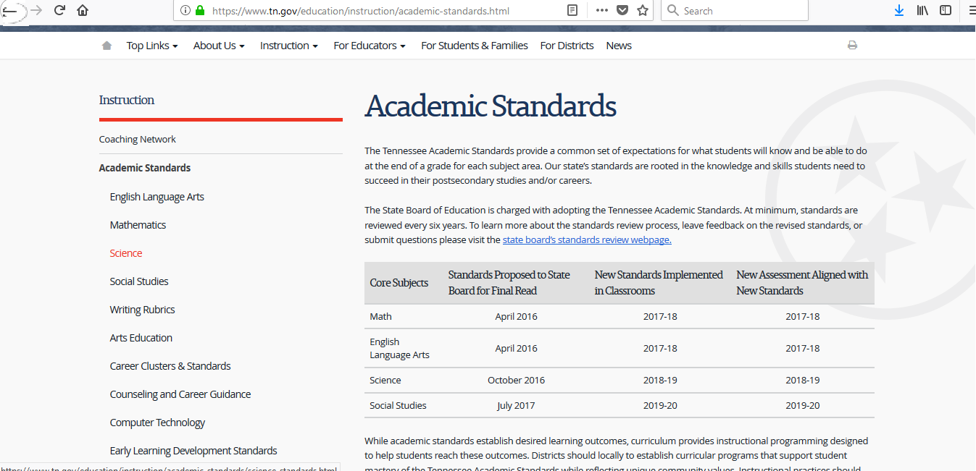
TN Academic Standards Reference
Click on Content Area
Notes:
1-2 minutes
Show participants where to click. You will find many state resources for your content area on this site.
Depending on the participants in your room – give them a few moments to access the state website on their mobile devices. Bring them back together before moving to the next slide.

Slide 7

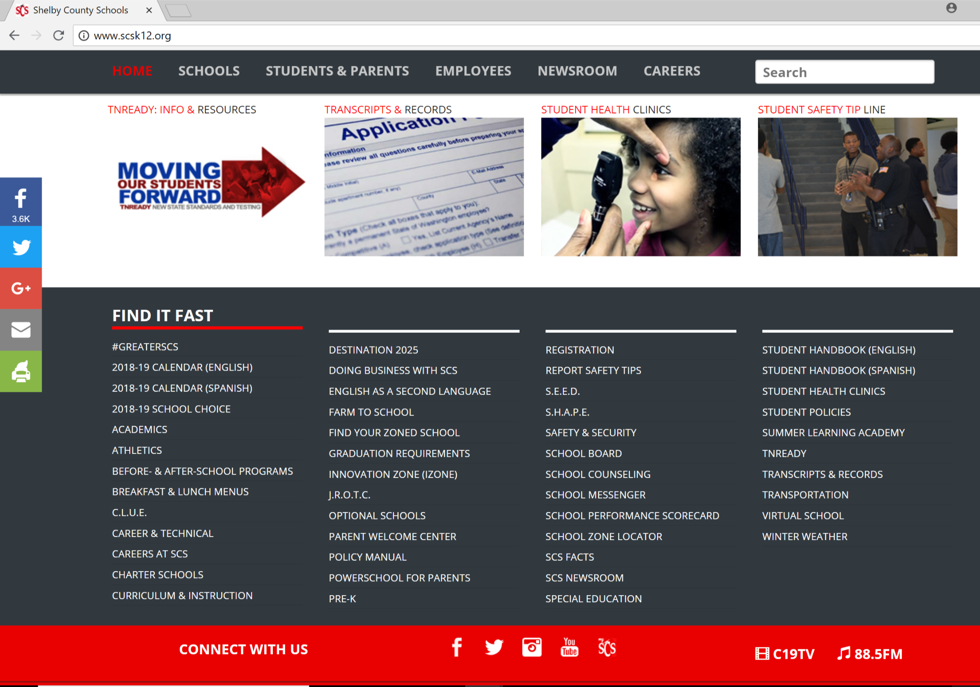
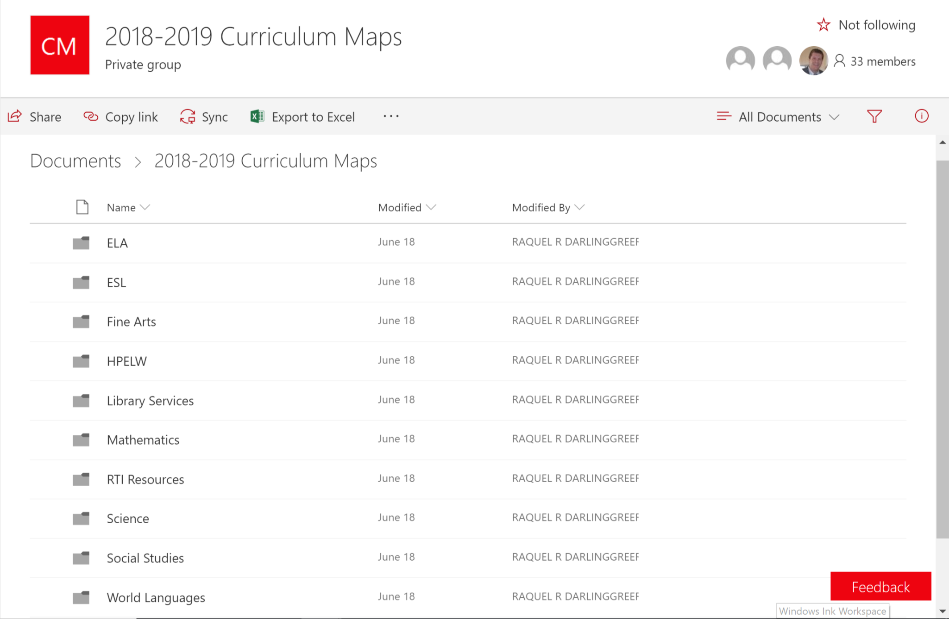
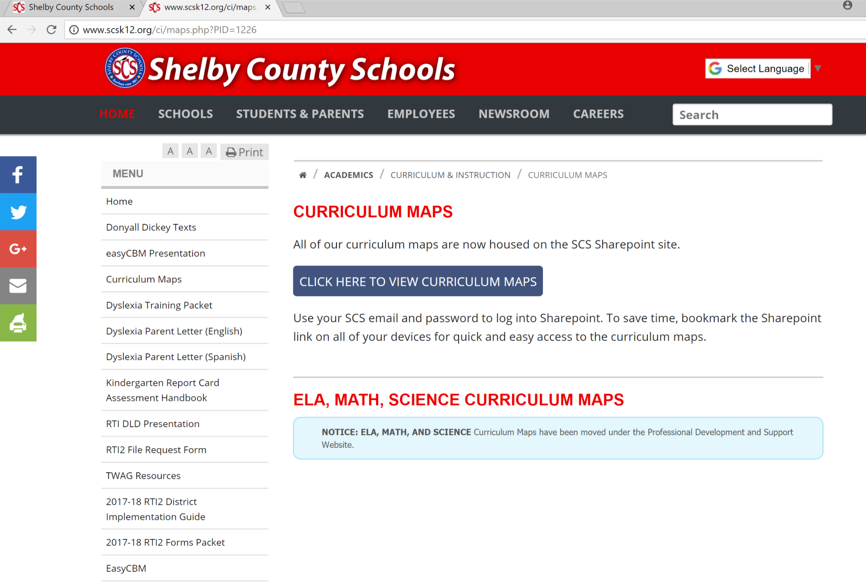

Accessing Curriculum Maps: SCS
Scroll down to the “Find it Fast” section
Notes:
2 minutes
As you begin to plan for instruction, you will need to access the SCS Curriculum Maps.
THIS IS AN ANIMATED SLIDE. CLICK TO PROGESS AS YOU PRESENT EACH ANIMATION IMAGE AND PROGRESS TO THE NEXT ONE.
SAY: Depending on the content that is being taught, there are various ways to access the curriculum and resources. One common way to do it, is through the SCS home page.
(CLICK)
SAY: To do this we go the SCS website and scroll all the way down to the FIND IT FAST section at the bottom of the page. (CLICK to make image disappear)
(CLICK)
SAY: Once there, click on the CURRICULUM & INSTRUCTION prompt. (CLICK to make image disappear)
(CLICK)
SAY: Click on the CURRICULUM MAPS section on the left side of the page. (CLICK to make image disappear)
(CLICK)
SAY: Click on the blue button that says, CLICK HERE TO VIEW CURRICULUM MAPS (CLICK to make image disappear)
(CLICK)
SAY: This is where content curriculum maps are located.
(Click)
SAY: Each Math folder is designated by grade band. You have a folder for curriculum maps and supporting documents. We will talk about the supporting documents in just a few moments.

Slide 8
New Teacher Temporary Q1 Access
http://www.bit.ly/scsnewteachermaps
Notes:
30 seconds
We know that many of you do not have an email address yet to access the Curriculum Maps. Therefore, we have created a temporary folder for you so that you can access the Quarter 1 Curriculum maps. Simply use the above web address and click on the grade level you need. This temporary access will be taken down the middle of August.

Slide 9
Turn and Talk
Where are two places that I can access resources to help me as I prepare for student learning?
Notes:
2 minutes
Have participants turn and talk answering the question above.

Slide 10
Agenda
Accessing TN State Standards/ SCS Curriculum Maps
Elementary ELA
Elementary Math
Elementary Science
Elementary Social Studies
Bridge to Practice
Accessing PLZ
Notes:
30 seconds
SAY: Here is our AGENDA for the day:

Slide 11
ELA

Slide 12

Taking a Closer Look at K-5 ELA
K-5 ELA:
Meaning-based Maps
Foundational Skills Maps
Supporting Documents
Notes:
The K-5 ELA curriculum contains a meaning based maps folder , foundational skills map folder and a supporting documents folder

Slide 13
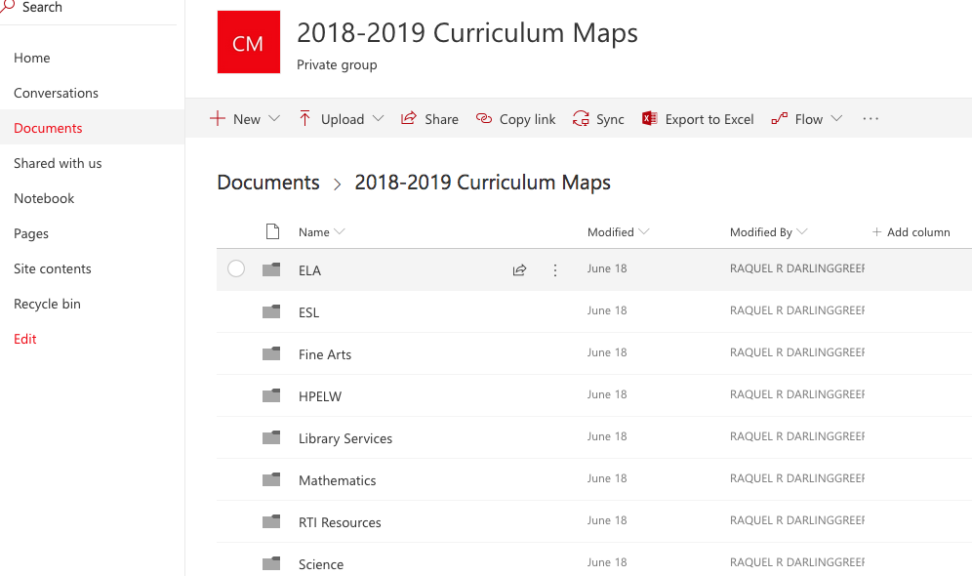
ELA
Notes:
To access the K-5 ELA maps select the ELA folder

Slide 14
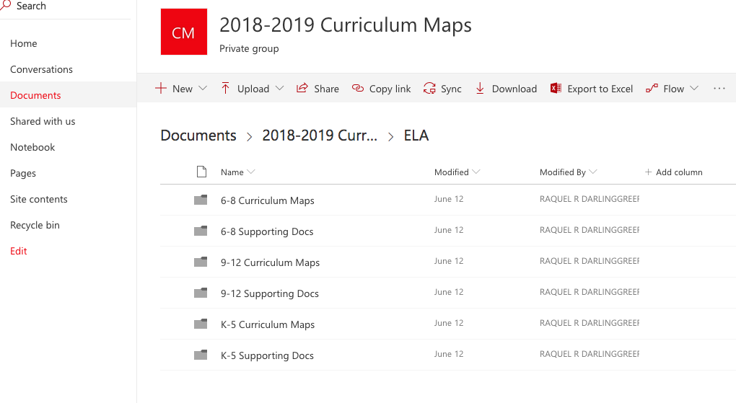
Select K-5 Curriculum Maps
Notes:
Notice there is both a K-5 Curriculum Maps folder and a K-5 Supporting Docs Folder. Let’s first look at the Curriculum maps by selecting the K-5 Curriculum Maps folder.

Slide 15
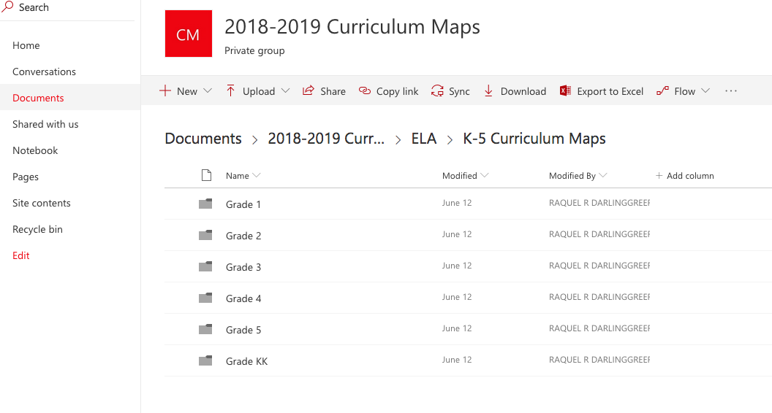
Select a Grade Level
Notes:
Here you notice a folder for grades K-5. Select the grade level of your choice

Slide 16
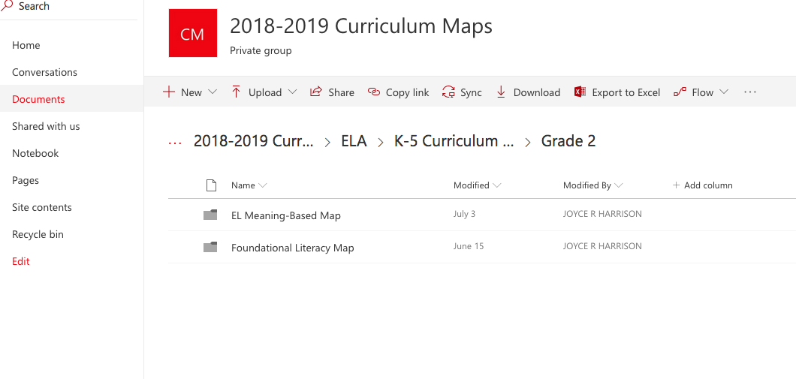
Meaning-Based Maps
Notes:
In K-5 ELA there are two maps to support ELA instruction. The meaning based maps which are designed around the EL Curriculum and the Foundational Skills Maps which are supported by Journeys materials. Let’s look at the meaning based maps.

Slide 17
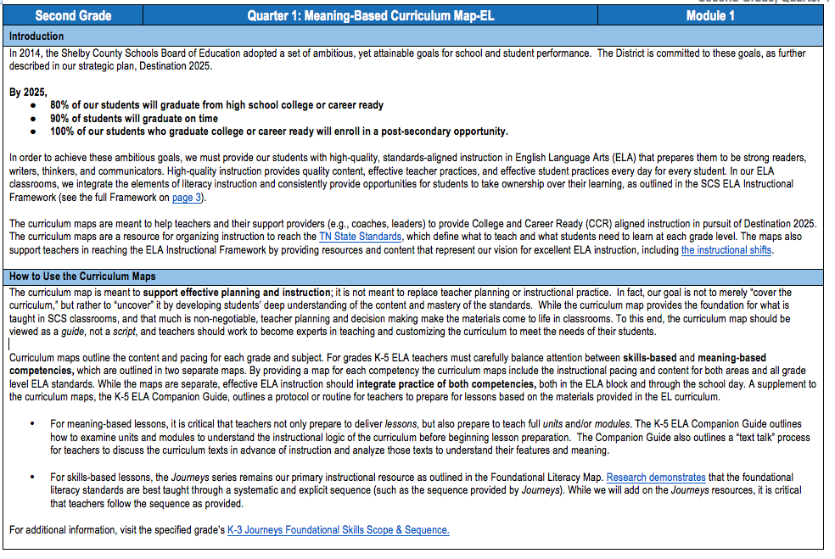
Notes:
The first few pages of the meaning based maps provide framing and guidance information regarding literacy instruction. One important point to remember which is stated on the first page of the maps is that the curriculum maps provide the foundation for what is taught in SCS classrooms, teacher planning and decision making make the materials come to life. To this end, the curriculum map should be viewed as a guide, not a script, and teachers should work to become experts in teaching and customizing the curriculum to meet the needs of their students.

Slide 18
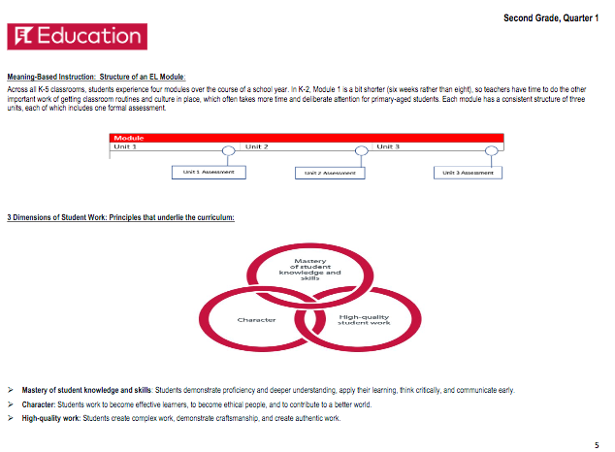
EL Curriculum
Notes:
The meaning-based maps highlight information taken from the EL literacy curriculum. The EL curriculum is a comprehensive, standards-based core literacy program that engages teachers and students through compelling, real world content and builds equitable and inclusive learning opportunities for all students. In grades K-5 the EL curriculum is broken up into 4 modules that focus on different topics. Each module has a consistent structure of three units each of which includes formal assessments.

Slide 19
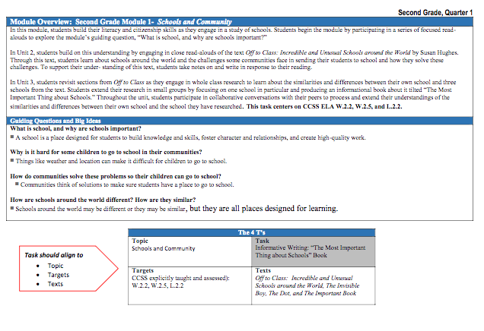
Notes:
The maps contain a module overview of the most salient points that include the modules topic, targets/standards, performance task and texts used throughout the module.

Slide 20
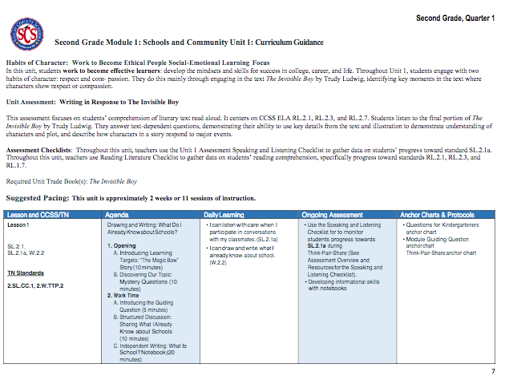
Notes:
The maps also contain unit at a glance information that highlights each lesson, the lesson’s standards, assessments and anchor charts or protocols.

Slide 21
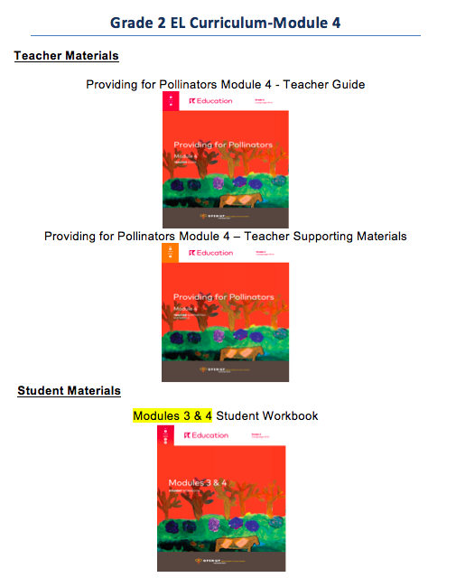

EL Materials
Notes:
This slide is animated
The EL instructional materials teachers receive and use in daily instruction are teacher guides and supporting materials manuals. Students receive workbooks as well as access to trade books. In K-5 one trade book per student is often provided. For certain titles only 1 book is provided, which is to be used by the teacher to read aloud to the students. This is often the case in grades K-2.

Slide 22
Foundational Skills Maps
Notes:
The other type of map provided in K-5 is the Foundational Literacy Map

Slide 23
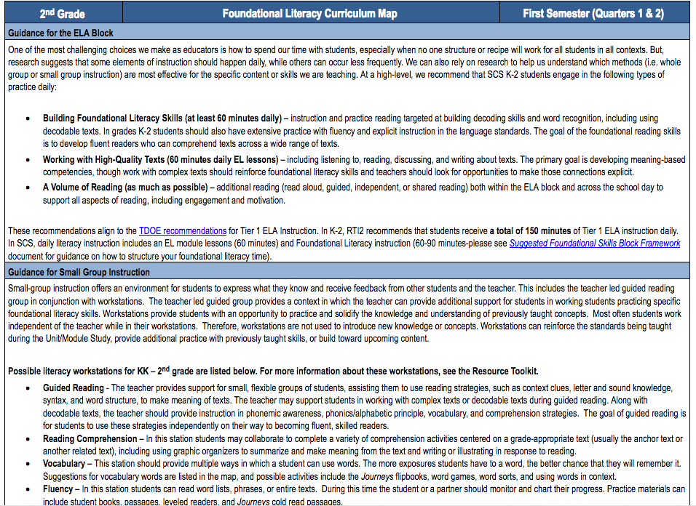
Notes:
Like the meaning based map, the foundational literacy map contains framing documents with important information like Guidance on the ELA Block as well as Guidance on Small Group Instruction. Teachers should peruse the first few pages of the maps for pertinent information.

Slide 24
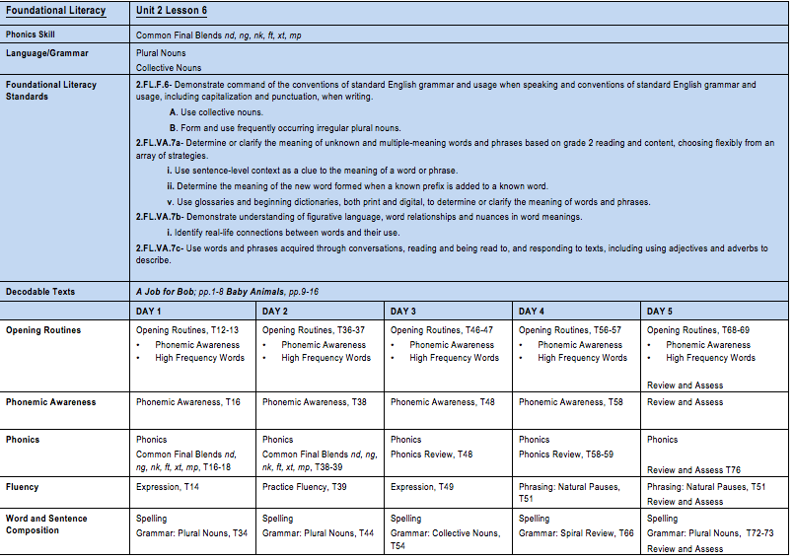
Notes:
The foundational literacy maps are designed around the Journeys Curriculum and align to Journeys’ scope and sequence. The foundational literacy map outlines the phonics skills, daily instruction, standards, and texts.

Slide 25

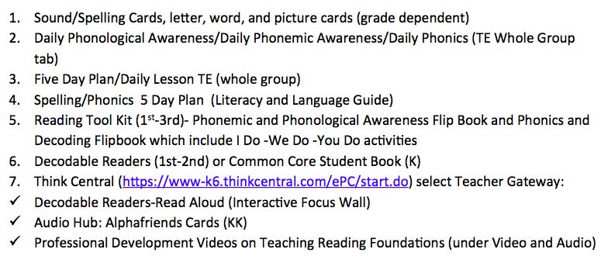
Journeys Materials
Notes:
Journeys provides a variety of resources to support foundational literacy instruction with the primary resource being the Journeys teacher’s edition. All hardcopies of Journeys materials can also be found on Journeys online platform called Think Central.

Slide 26
K-5 Supporting Documents
Notes:
In K-5 there are a number of supporting documents designed to support literacy instruction. These documents can be accessed by selecting the K-5 Supporting Docs folder.

Slide 27
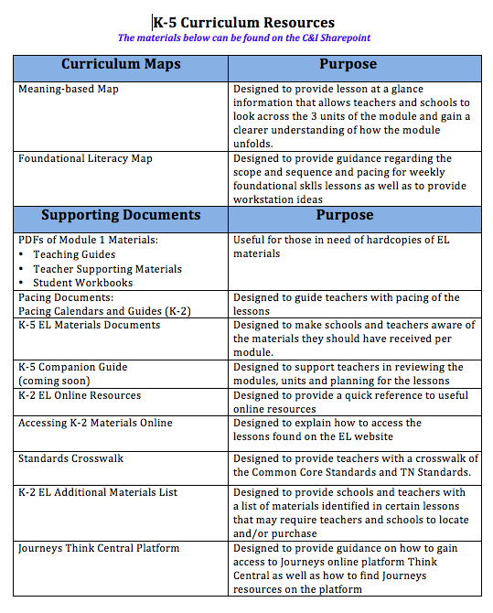
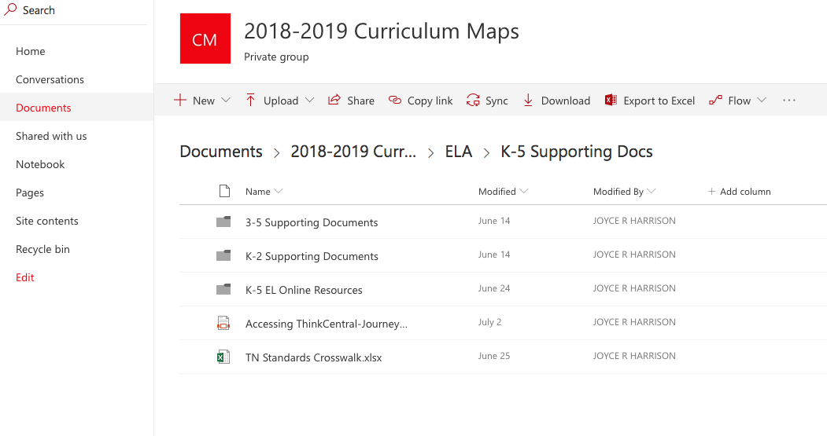
Online Supporting Documents
Notes:
Once selected teachers will see a list of supporting documents such as pictured here. Rather than review each document, the K-5 Curriculum Resources list provided in your handouts and featured here on the right outline the various supports that each document provides. Some of the most useful documents are around pacing. The pacing documents provide information for teachers around how to pace the lessons. Another very useful supporting documents is the Journeys Think Central document that walks teachers through how to access Journeys online platform, which is called Think Central, This platform gives teachers access to all Journeys materials but in an online format.

Slide 28
ELA Review Activity
Moving Partner Review
What are the two types of ELA maps?
What are some of the supports found in the Supporting Docs folder?
Notes:
Before we examine the next content area let’s do a quick review. Ask questions and allow teachers to turn/talk/share out (if time allows).
Engage participants in an activity where they will get up and walk around the room until you say stop (you can add music for fun) After they stop ask them to find a partner by high fiving a person around them. Have the partners discuss and answer the questions on the slide. Have a few groups share out their answers.
Answers:
1. Meaning based maps and foundational literacy or skills maps
2. Teachers can list any of the items found on the handout like Journeys Think Central Doc or pacing guides

Slide 29
For Additional Support Regarding ELA
Department of Curriculum and Instruction
Joyce Harrison, Instructional Advisor: harrisonjr@scsk12.org
Department of Professional Development and Support
Matara Harris, Support Advisor: harrismc@scsk12.org
Brenda Matthews, Support Advisor: matthewsbf@scsk12.org
Vivian Burkley, Support Advisor: burkleyvm@scsk12.org
Angela Samuels, Support Advisor: samuelsag@scsk12.org
Hajar Nelson, Support Advisor: nelsonh@scsk12.org
Rachelle Taylor, Support Advisor: taylorr@scsk12.org
Shayda Rankin, Support Advisor: rankinsd@scsk12.org
Elizabeth Patterson, Support Advisor: pattersone2@scsk12.org
Tressa Jones, Support Advisor: jonestb@scsk12.org
Tekeesha Jeans, Support Advisor: Hendersontj@scsk12.org
Danielle Harris, Support Advisor: harrisda1@scsk12.org
Notes:
Before we examine the next content area let’s do a quick review. Ask questions and allow teachers to turn/talk/share out (if time allows).
Engage participants in an activity where they will get up and walk around the room until you say stop (you can add music for fun) After they stop ask them to find a partner by high fiving a person around them. Have the partners discuss and answer the questions on the slide. Have a few groups share out their answers.
Answers:
1. Meaning based maps and foundational literacy or skills maps
2. Teachers can list any of the items found on the handout like Journeys Think Central Doc or pacing guides

Slide 30
Agenda
Accessing TN State Standards/ SCS Curriculum Maps
Elementary ELA
Elementary Math
Elementary Science
Elementary Social Studies
Bridge to Practice
Accessing PLZ
Notes:
30 seconds
SAY: Here is our AGENDA for the day:

Slide 31
Math

Slide 32
SCS Mathematics Instructional Framework
The purpose of the SCS Mathematics Instructional Framework is to provide a vision of Mathematics Instruction for SCS schools. The implementation of this framework will increase our capacity to improve student’s mathematical skills by outlining research-supported instructional practices and a shared language for what effective math instruction looks and sounds like in Shelby County Schools. We believe that consistent use of these practices in every classroom could make a measurable positive difference in SCS Math achievement.
These practices should be viewed as a minimum standard of mathematics instruction for SCS, not as an exhaustive list of mathematical instructional practices.
Notes:
1 minute
Give participants a moment to read the slide.

Slide 33
SCS Mathematics Instructional Framework
In our Math classrooms:
Students engage in the most important content.
Students build on what they already know.
Students learn the “how's and whys” of math and apply it to the world around them.
Students do the thinking.
Effective mathematics instruction requires research-based instructional practices which include:
Thoughtfully planned and executed lessons.
Environments that supports student mathematical discourse.
Data-informed instruction.
Visual and symbolic representations.
Literacy skills for mathematical proficiency.
Notes:
2-3 minute – handout will be provided
Allow participant 1 – 2 minutes to read the slide
You will most likely be seeing this information throughout the year. We want you to start familiarizing yourself with the language and the SCS expectations around Math Instruction. At District Learning Day we will review this again and have you engage in a discussion.
Consider having participants read the bullets.

Slide 34
Key Instructional Shifts
The TN State Content Standards represent three fundamental shifts: focus, coherence, and rigor.
  Focus: The standards are focused on fewer topics so that students can learn more.
  Coherence: Topics within a grade are connected to support focus, and learning is built on understandings from previous grades.
  Rigor: The standards set expectations for a balanced approach to pursuing conceptual understanding, procedural fluency, and application and modeling.
Notes:
1 minute:
We want to introduce the three fundamental shifts in Math Instruction:
Focus – we are now focusing on fewer topics in each grade so that students can learn that content deeply.
Coherence – Math Concepts have been strategically designed to build on understandings from previous grades as well as connect what is learned in the current grade.
Rigor – This shift sets expectations of a balanced approach to learning – conceptual understanding – procedural fluency and application and modeling. You may see a distinct variation in how you were taught versus what is expected in mathematic instruction today. Building conceptual understanding, instead of relying solely on procedural skill is the reason for this variation.

Slide 35
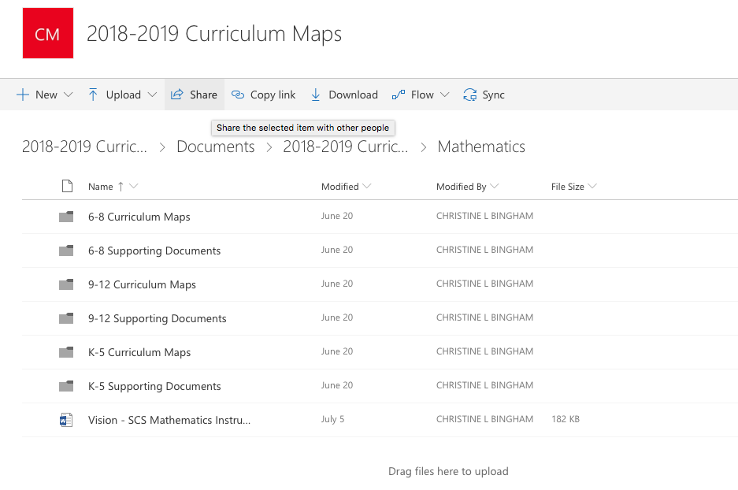
Elementary Math
Notes:
I minute
(Click)
SAY: Like ELA the Math folder is designated by grade band. You have a folder for curriculum maps and supporting documents. We will talk about the supporting documents in just a few moments.

Slide 36
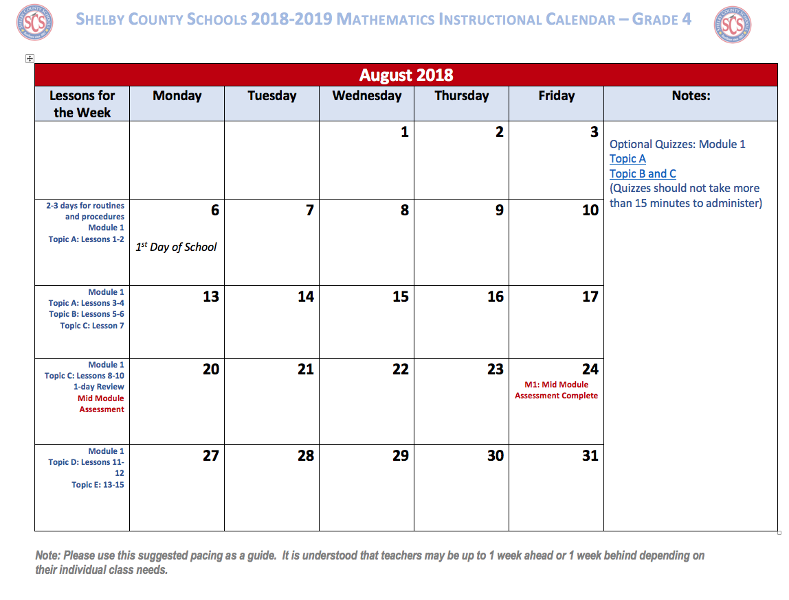
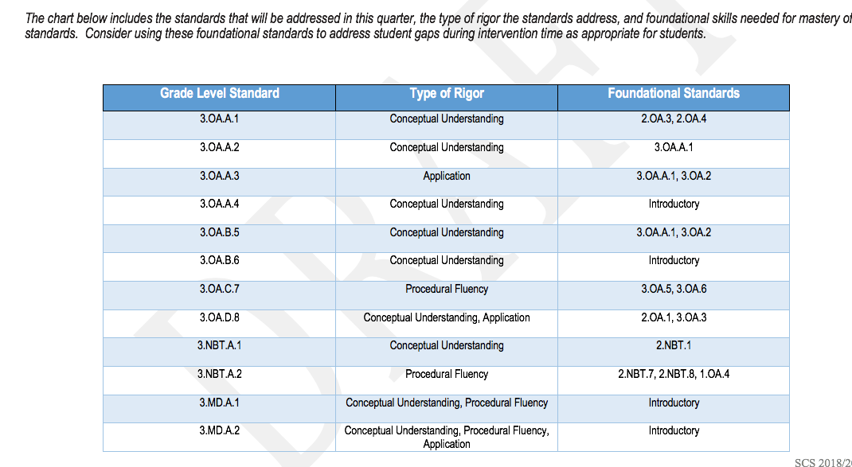
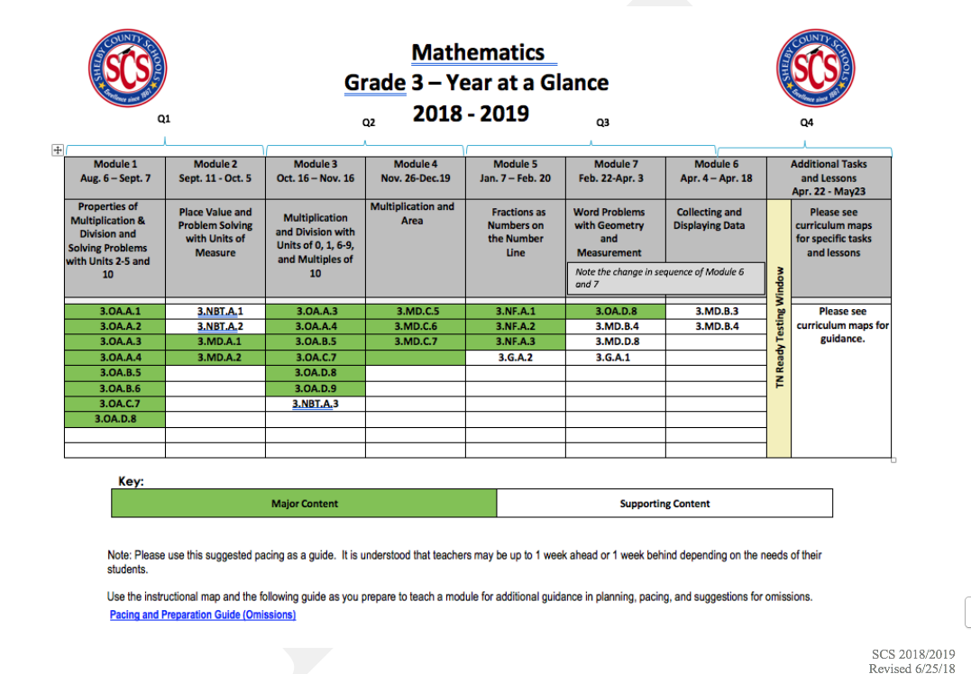
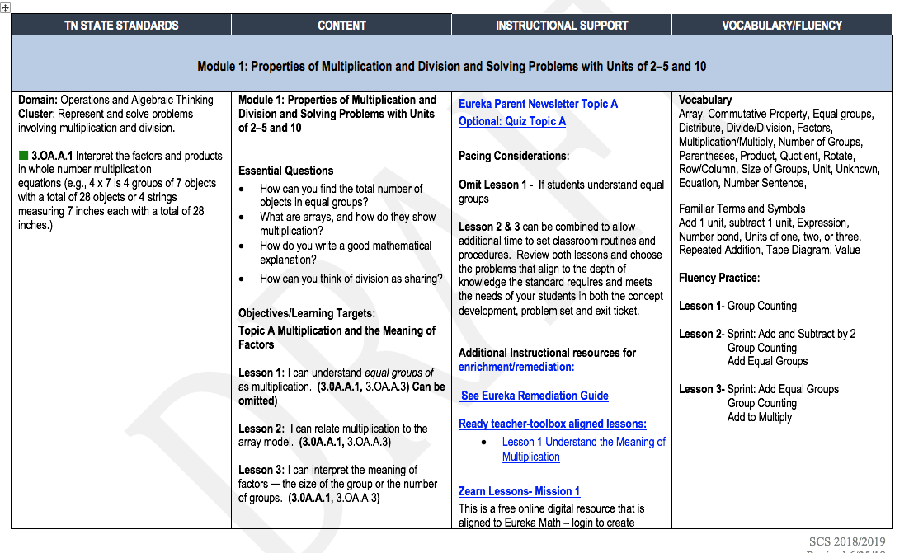
K-5 Elementary Maps
Notes:
5 minutes
We told you how to access the curriculum maps through the website – but what exactly will I see.
(CLICK)
Say: Once you have opened your Q1 Curriculum Map – you will see the year at a glance. This gives you a look at how the modules will unfold throughout the year. (If questioned – in regards to pacing special consideration was given to TN Ready testing – if teachers follow the instructional calendar – all standards have been addressed prior to the expected test date. This information is indicated on the year at a glance. Please note that we do NOT have the actually test date as of yet, but are using past years as a predictor)
(CLICK)
The chart includes the standards that will be addressed in this quarter, the type of rigor the standards address, and foundational skills needed for mastery of these standards. - We know that many of our students have ”unfinished learning” from previous years. Consider using these foundational standards to address student gaps during intervention time as appropriate for students.
(CLICK)
As you continue to navigate through the pages – you will see a page with 4 columns. The first column includes the TN State Standard that will be addressed in each topic. The second column includes the objective for each lesson, along with some essential questions. In the third column, you will find links to the Eureka Parent Newsletter, Optional Topic Quizzes, Remediation/Enrichment tools, as well as specific videos and tasks aligned to each topic. The last column includes the academic vocabulary for the module along with the fluency exercises for the topics and lessons.
(CLICK)
We gave included an instructional calendar to help teachers with pacing. In the notes section you will see additional guidance and links to Optional Topic Quizzes. You can access the entire year by going looking at the supporting documents folder.
Allow teachers some time to review the Quarter 1 Curriculum maps. (We will provide a Google Document so that new teachers can access the Quarter 1 folders – temporarily)
We will be sharing this information again at district learning day – so if you are starting to feel overwhelmed – don’t worry.

Slide 37
Supporting Documents and Resources
Supporting Documents
Eureka Parent Newsletters Common Planning Companion Guide Sample Annotated Lessons IPG – Instructional Practice Guide Collaborative Planning Agendas Comparison Documents Prep and Pacing Guides Instructional Calendar Year at a Glance Kindergarten Assessment Handbook SCS Instructional Framework Remediation Guides Eureka Remediation Tools Quizzes K-8 Task Bank K-5 Instructional Focus Documents Quarter at a Glance Additional Resources Document
Notes:
2 minutes – Handout
This is a list of supporting documents that you will find on our website as well as throughout our curriculum map. Again – we will take a more in-depth look at these during District Learning Day

Slide 38
Resources
Teacher Editions
Student Editions – Problem Sets and Homework
Student Workbook B – Sprint & Fluency, Exit Tickets, Mid and End of Module Assessments
Digital Access: www.greatminds.org
Notes:
2 - 3 minutes
Say: Some of the resources you will find waiting for you are as follow:
Teacher Editions – You will be able to make notes and annotate in your Teacher Edition – we do strongly suggest you use pencil.
You will receive two types of Student Editions for each student. Both are consumable workbooks with perforated pages. One book will contain the problem set and homework for the days lesson. The other workbook will contain the Sprint & Fluency, Exit Tickets and Mid and End of Module Assessments you will need. All of these materials have been delivered to schools.
We also want to make sure you know that you can access digital resources at www.greatminds.org. Just sign up for the free account.

Slide 39
Activity
Notes:
Time: 3 minutes
Materials Needed:
Sprint Activity – in handout (or separate copy may be given to you)
Sprint Answer Key (for facilitator)
Door prize
Let’s build a little energy and enthusiasm for Math. It’s time to do a little Math. We are going to do a modified version of a sprint
Turn to the Page________ in your participant packet. Pencils/Pens in the air. You will have one minute to complete the sprint activity – do not start until you hear the key word “think”. Ready, Set, Think. Give ONLY 1 minute for completion. Have them put their pencils down. Read the answers from the answer key – if the student got the answer correct have them answer yes. If they did not get it correct or did not answer they will stay silent. Have them write the number they got correct at the top of their page.
Winner Receives a copy of the Math Standards Companion Guide - If you have multiple winners please narrow down by asking them to choose a number and give to the participant with the closest number.

Slide 40
Contact Information
Advisors with the Department of Professional Development and Support
Tracey Brown browntr@scsk12.org
Ikecia Griffith griffithi1@scsk12.org
Karen Hughes Hughesks@scsk12.org
Camesha Richardson richardsoncm@scsk12.org
Rachael Spriggs Spriggsrg@scsk12.org
Amber Strong Strongal@scsk12.org
Advisors with the Department of Curriculum and Instructions
Christine Bingham binghamcl@scsk12.org
Sonia Barber Barbersp@scsk12.org
Notes:
1 min

Slide 41
Agenda
Accessing TN State Standards/ SCS Curriculum Maps
Elementary ELA
Elementary Math
Elementary Science
Elementary Social Studies
Bridge to Practice
Accessing PLZ
Notes:
30 seconds
SAY: Here is our AGENDA for the day:

Slide 42
Science
Notes:
0 min
Transition only

Slide 43
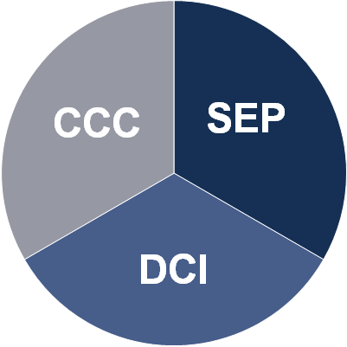
Three Dimensional Science Instruction
Science and Engineering Practices (SEPs)
Disciplinary Core Ideas (DCIs)
Crosscutting Concepts (CCCs)
Notes:
1 min
Say: The new science standards are three dimensional. The three dimensions are: Science and Engineering Practices, Disciplinary Core Ideas and Crosscutting Concepts.
The Science and Engineering Practices describe behaviors/actions that scientists and engineers engage in as they build and refine scientific knowledge and develop solutions.
Disciplinary Core Ideas represent the content of the new standards.
Crosscutting Concepts are underlying concepts that cross disciplinary core boundaries and bridge different aspects of science.
The science classroom is shifting away from ‘learning about science’ to ‘figuring out science’!

Slide 44

TN Science Standards
Reference Guide
www.tn.gov/education
Notes:
30 sec
Say: Earlier – we showed you how to access the TN Academic Standards through the TN State Website. We want to specifically call out the TN Science Standards Reference guide.

Slide 45
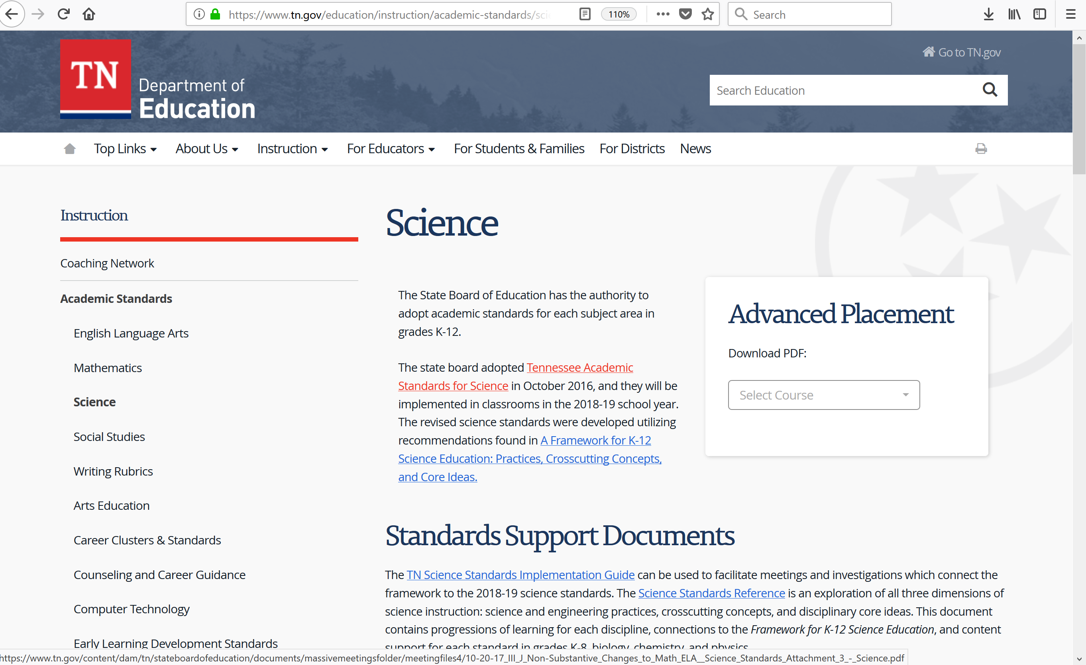
TN Science Standards Reference
CLICK HERE
Notes:
30 sec
Show participants where to click. - You will find this document on the webpage with the Science Academic Standards.

Slide 46
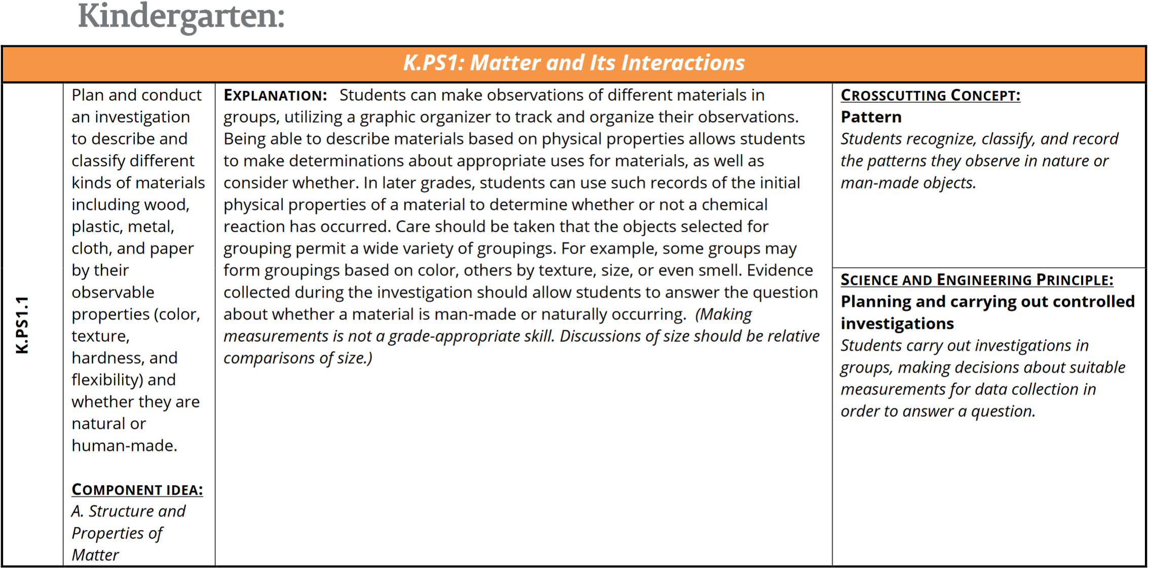
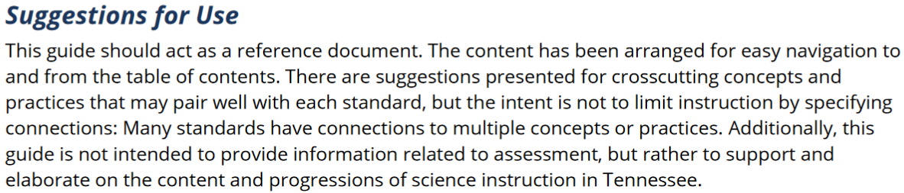
TN Science Standards Reference
Crosscutting Concept (suggested)
Disciplinary Core Idea
Standard
Explanation
Science & Engineering Practices (suggested)
Connection to the Framework
Notes:
2 min
Say: This is what the TN Science Standards Reference document looks like. To the right is how each standard is presented. Take a moment to look at the different components that make up standard K.PS1.1. <PAUSE> The coding for the standard is in the leftmost column, followed by the standard itself in the next column. The third column has an explanation, which may provide information about coherence and scope. Finally, in the rightmost column, the state has provided a SUGGESTED Crosscutting Concept and Science and Engineering Practice. We'll have the chance to discuss these standards in greater depth during District Learning Day.

Slide 47

How Did We Get Here?
Deepen Understanding of Key Components of
SEPs
CCCs
DCIs
SCS Curriculum Scope and Sequencing
TN Academic Science Standards
July 2011
January 2018
Notes:
2 min
Say:
The TN standards were developed utilizing the recommendations found in a document called "A Framework for K-12 Science Education".
Think of it as the parent document to our TN standards (other states have done the same thing and used this document as a guide to create their own standards)
So much so that the state of TN actually hands out copies of the Framework at training events. That being said, in TN used the framework as a guide and did not take 100% of the suggestions made within the Framework. So, if there is a question as to which document to follow, the TN documents take priority.

Slide 48
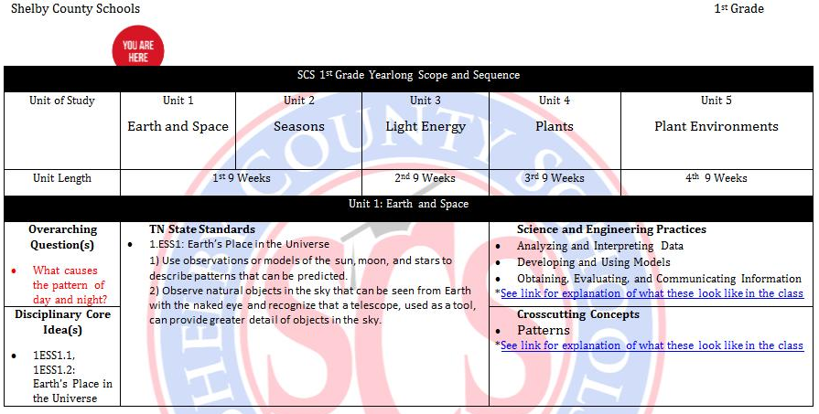
Scope and Sequence
Notes:
1 min
Do: Point out the various sections of the SS.
Say: This is an example of the elementary scope and sequence. Notice the components: the unit of study is across the top, the length of each unit is the second line, the bottom portion address the vital information such as the DCI, essential question, TN standards, Science and Engineering Practices and Crosscutting Concepts for the unit.

Slide 49
Quarter 1 Map
Notes:
1 min
Do: Point out the various sections of the Q1 Map. The first row lists the unit and title. The second row is the time frame for each unit. The third row has the essential question/overarching question. The remainder of the map lists the lesson name along with number, the length of the lesson, the DCI, Explanation, Misconceptions, Phenomena, SEPs, and CCCs.

Slide 50
Activity – Rock, Paper , Scissors
Notes:
Time: 5 minutes
Activity – Rock, Paper Scissors
If you will be teaching 3rd grade – One of the units you will be working on in the first semester is Matter – Including Physical Change and Chemical change. A physical change in a substance doesn't change what the substance is. (for example: breaking a glass) In a chemical change where there is a chemical reaction, a new substance is formed and energy is either given off or absorbed. (for example: burning wood) We are going to engage in a quick fun activity thinking about these changes. Stand up and find a partner in a different part of the room. Does everyone know how to play rock paper scissors? Model each element if needed. When I say “three” show your partner either rock paper or scissors. One Two Three – Now tell your partner something that you can do with your element that would cause a physical change. Repeat the process – have them tell their partner something that would cause it to have a chemical change.
Physical Change:
Rock: - Water – rain cause it to break apart
Scissors – Become dull or break
Paper – tear paper
Chemical Change:
Scissors could be immersed in water – causing them to rust
Rock – heat and pressure can change rock into a metamorphic rock (chemical weathering can happen as well)
Paper – Can be burned turns to ash

Slide 51
Contact Information
Advisors with the Department of Professional Development and Support
Courtney Skipper K-5 skipperc@scsk12.org
Tracy Leaks 6-8 leaksta@scsk12.org
Agata Jedrzejewski 9-12 jedrzejewskia@scsk12.org
Advisors with the Department of Curriculum and Instructions
Terilyn McChriston K-5 mcchristontj@scsk12.org
Kimberly Jackson 6-8 jacksonkd@scsk12.org
Shalanda Saulsberry 9-12 saulsberryst@scsk12.org
Notes:
1 min

Slide 52
Agenda
Accessing TN State Standards/ SCS Curriculum Maps
Elementary ELA
Elementary Math
Elementary Science
Elementary Social Studies
Bridge to Practice
Accessing PLZ
Notes:
30 seconds
SAY: Here is our AGENDA for the day:

Slide 53
K-5 Social Studies

Slide 54
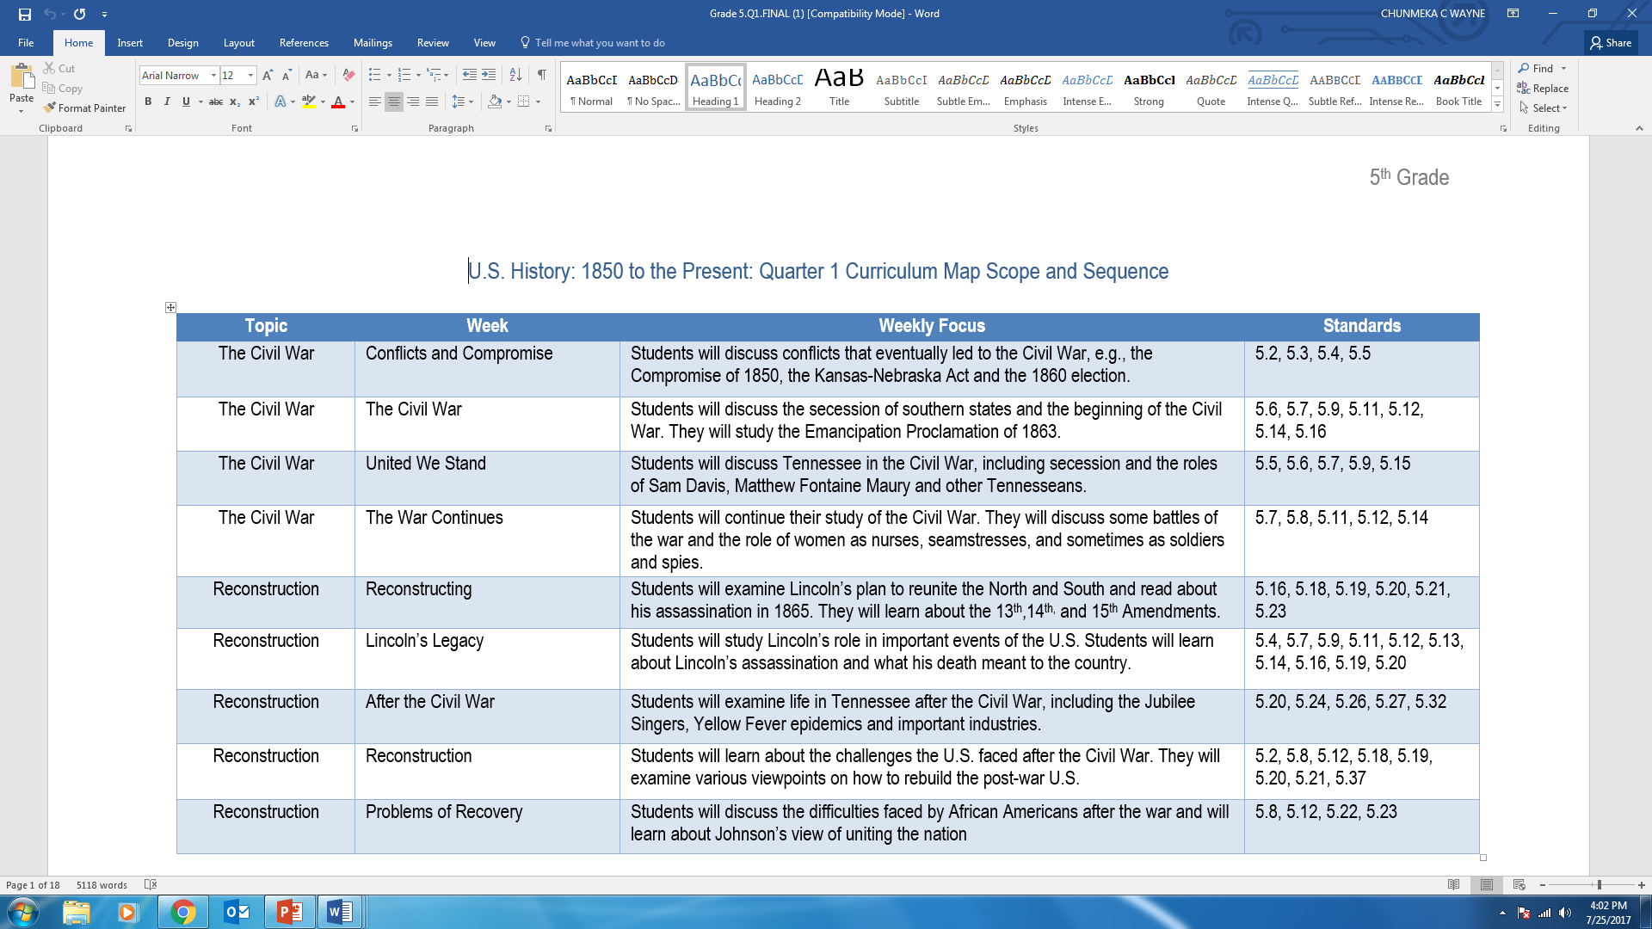
Curriculum Map Scope and Sequence
Notes:
When getting started with the elementary social studies curriculum map, you will notice the scope and sequence. The social studies scope and sequence headings are topic, week, weekly focus and standards. The topic for the week coincides with the eras or content strands for the state standards for social studies. As you can see here, 5th grade has Civil War as a topic for 4 weeks. You can also see that even though the topic is the same, the weekly selection/text differs. The text for week one is Conflict and Compromise and the text for week 2 is Civil War.
The weekly focus column gives a general synopsis of what students will learn for the week and the standards column houses the standards number of the standards addressed for the week.

Slide 55
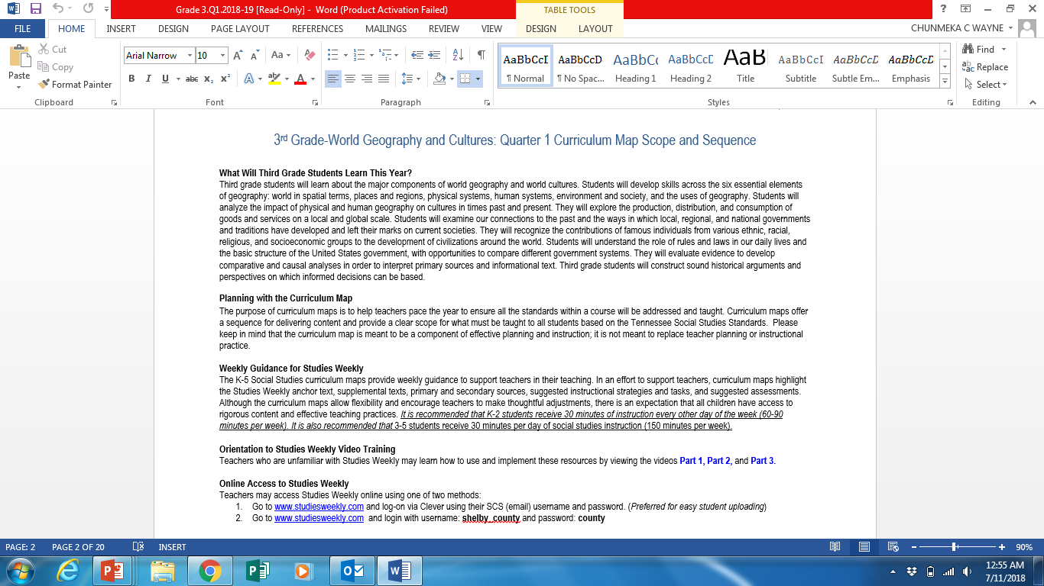
Curriculum Map Introduction
Snapshot of what students will learn throughout the year
Time recommendations for social studies instruction
Getting StartedVideos
Studies Weekly online access
Notes:
The elementary curriculum map introduction gives teachers a snapshot of what students will learn throughout the school year.
It shares the purpose and implementation of the curriculum map. It also shares the recommended times for teaching social studies.
It is recommended that K-2 students receive 30 minutes of social studies instruction every other day. That is approximately 60-90 minutes per week.
For grades 3-5, it is recommended that students receive 30 minutes social studies everyday. That is 150 minutes per week of social studies instruction.
Please keep in mind that although these are recommendations from the Department of Curriculum and Instruction, your building administrator has the final word on recommended times for instruction.
At the bottom of the first page of the introduction, information is provided on how to access the the District-wide non traditional textbook, Studies Weekly. There are links to video to help you get stated with using the resources as well as the username and password for online access to the resources.

Slide 56
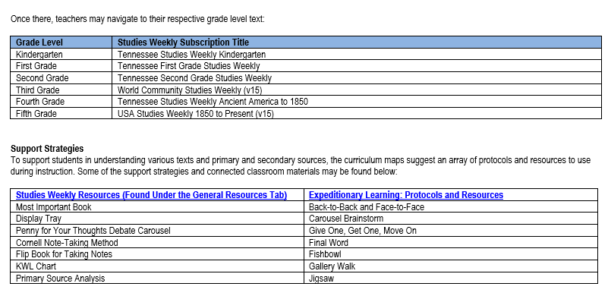
Studies Weekly Titles and Support Strategies
Notes:
The next page of the curriculum map introduction details the titles of the Studies Weekly resources by grade level.
On this page you will also find links to supporting strategies that may appear through the curriculum map. There are live links that will give you instant access to resources and descriptions of resources and protocols that can be used on a daily basis.

Slide 57
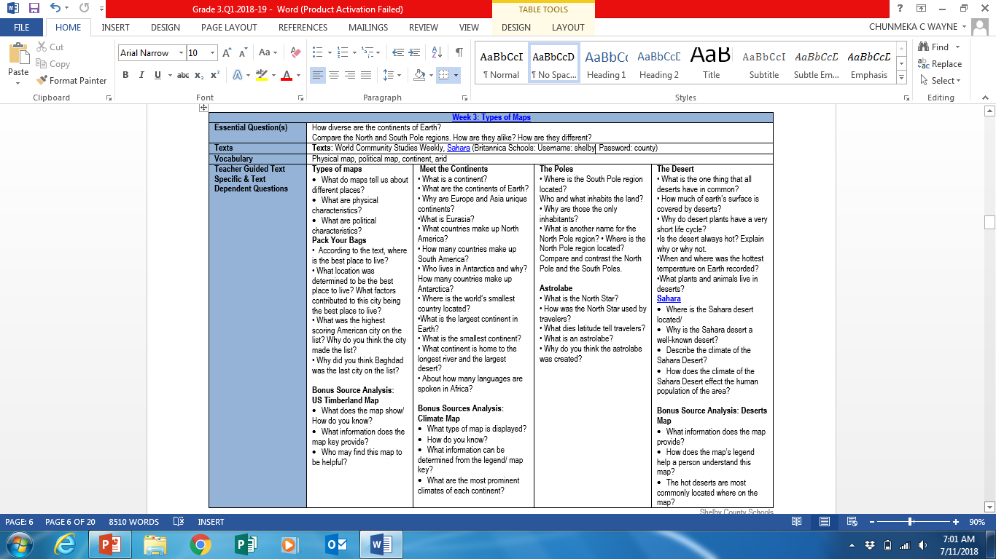
Essential Questions, Vocabulary, Texts, and TDQs
Notes:
The next pages of the curriculum map get us to the core of the weekly lesson. We start with essential questions, the selected texts for the week, and the then teacher guided text specific and text dependent questions. The text specific and text dependent questions are aligned to the text/ or resources of the column. Each subtext from Studies Weekly will have text dependent questions for students to answer in an effort to scaffold comprehension of the text.

Slide 58
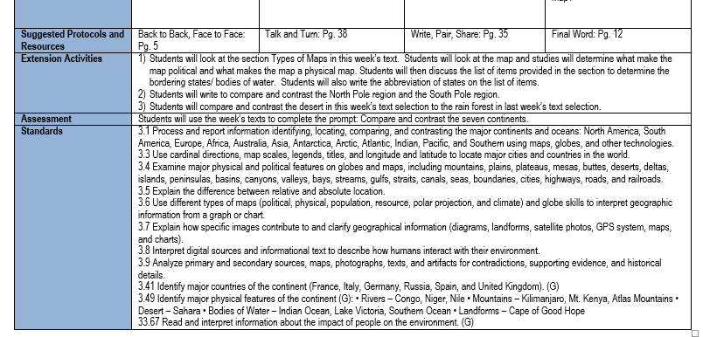
Protocols, Extension Activities, Assessments, and Standards
Notes:
Once you have the text dependent and text specific questions, how do you attack them with the students? The curriculum map provides suggestions on how to answer the questions. Here you can see the EL protocols Back to Back, Face to Face, and Talk and Turn. Please note that the page numbers next to the suggested protocols coincide with the pages of the EL protocols guide found in the link of the introduction.
We then have activities, a weekly assessment, and the wording of the standards addressed for the week.

Slide 59

Social Studies Resource
Studies Weekly
Notes:
Let’s take closer look at Studies Weekly

Slide 60


Easy Access to Studies Weekly: www.edugoodies.com
Notes:
The primary District-wide social studies resource for Shelby County Schools is the non-traditional textbook: Studies Weekly.
For easy access to Studies Weekly and other sites you may need access to throughout the year, visit www.edugoodies.com and click on the SCS tab.
Once there, you will find an array of resources, including Studies Weekly. Because you are new to the District, you will login using the Studies Weekly tab. After you receive your SCS email, you can access Studies Weekly via Clever.
After you click the Studies Weekly tab, click log-in.

Slide 61


Studies Weekly Login
Username: shelby_county
Password:
county
Notes:
You will then enter the following credentials:
Username: shelby_county (No caps)
Password: county (No caps)
If you every forget the username and password, it can be found on the first page of the curriculum introduction.
Once there, you select your grade level.
Please note that the titles of texts by grade level are found in the introduction of the curriculum maps.

Slide 62
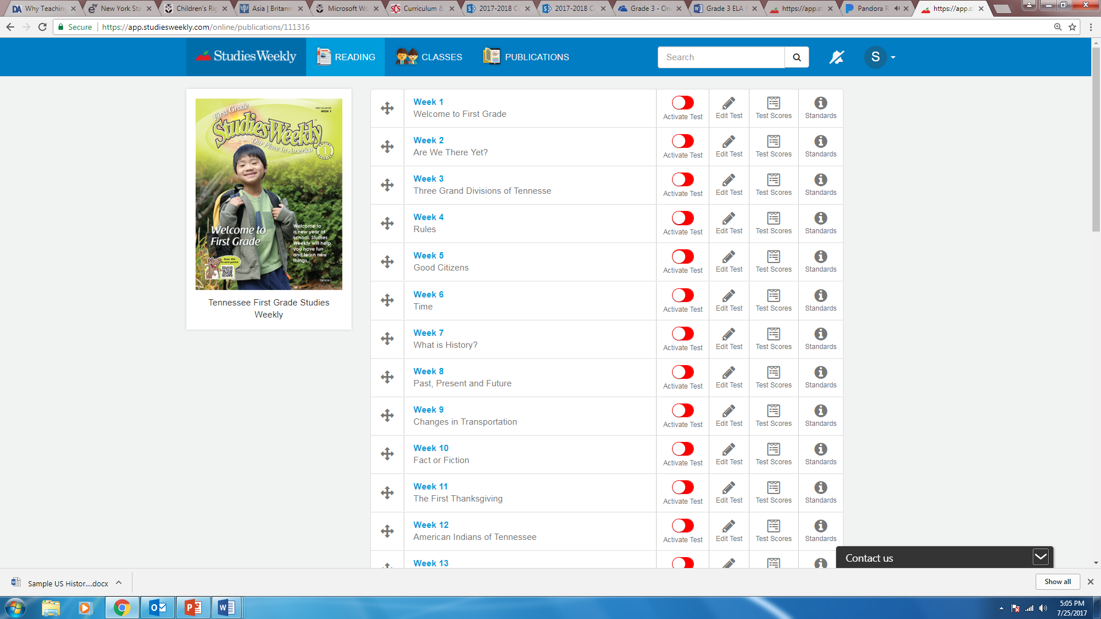
Reading Tab
Notes:
Once you click your grade level subscription text, you will have the option to pick the weekly selection of your choice.

Slide 63
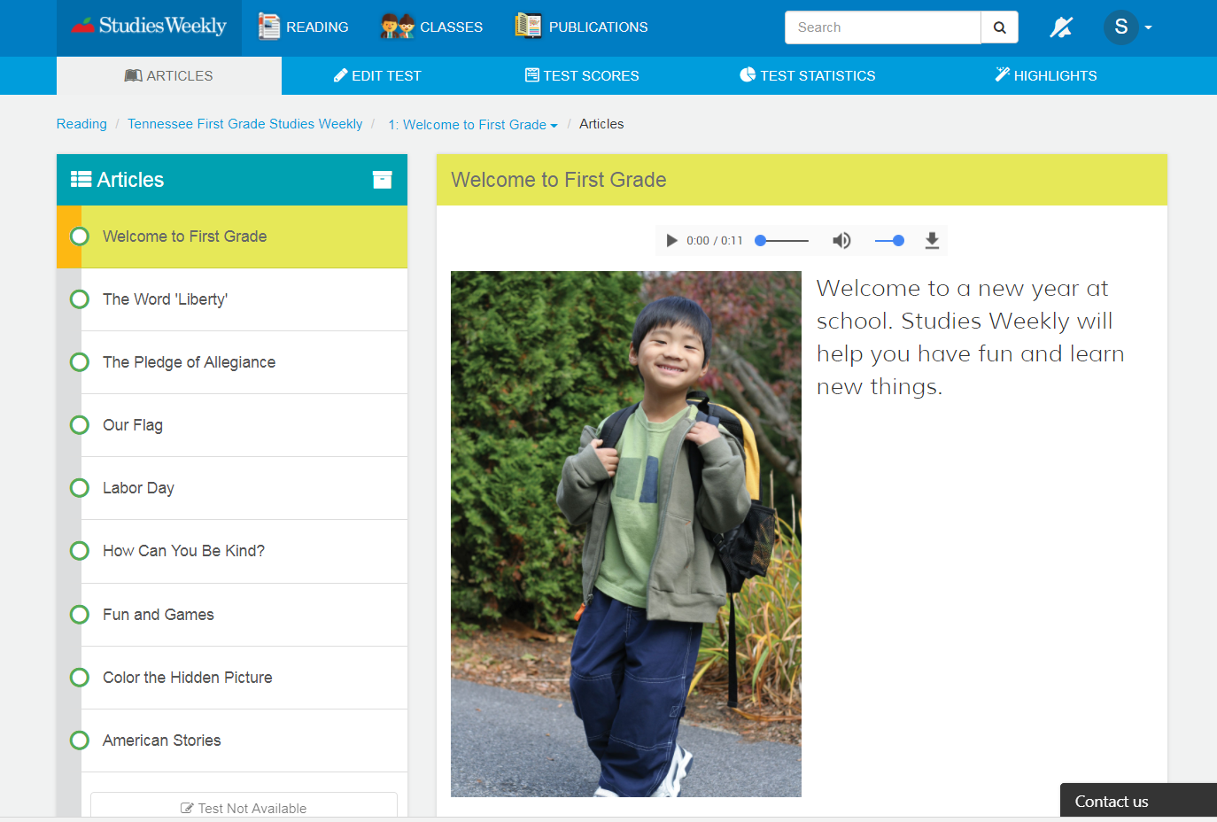
Articles Tab
Notes:
The online version of the weekly selections are identical to the printed weekly selections for students. The District has an annual subscription for each student. You will learn more about the Studies Weekly resources during the Social Studies District Learning Day session. If you do not get a chance to make it to the District Learning Day session, the social studies department will be hosting professional development sessions on implementation of curriculum maps and Studies Weekly throughout the semester.

Slide 64

Activity – Give One, Get One
Notes:
2-3 Minutes
Materials needed: Back of handout or sheet of paper
Give One, Get One
Have participants create a T-chart on their paper. Label the right side – Give One. Label the left side get one.
1)
Let’s look at this tweet from Studies Weekly. Have a participant read the slide. On the right side of your paper under Give One – As you embark on a new experience with education write one word thoughts that come to your mind as you think about this quote.
2)
Tell participants to walk around and find a partner. Each partner “gives,” or shares, items from his or her list. For example, Partner A shares his/her responses until Partner B hears something that is not already on his/her list. Partner B writes the new response in the right-hand column on the paper, along with Partner A’s name. Once Partner B has “gotten” one, the roles switch. Students repeat this process with other peers until time runs out.

Slide 65

Social Studies Questions?
Chunmeka Wayne
K-5 Social Studies Instructional Advisor
waynecc@scsk12.org

Slide 66
Agenda
Accessing TN State Standards/ SCS Curriculum Maps
Elementary ELA
Elementary Math
Elementary Science
Elementary Social Studies
Bridge to Practice
Accessing PLZ
Notes:
30 seconds
SAY: Here is our AGENDA for the day:

Slide 67
Bridge to Practice
Align with your new teacher orientation leader to assist with accessing curriculum and materials.
Commit to studying and becoming familiar with accessing your content’s curriculum in preparation for the first week of school.
Answer the following questions as you complete the Bridge to Practice:
  What materials will I need to study in preparation for the first week of school?
  What supports will I need as I study and prepare?
Notes:
2 minutes
Now! We’ve done quite a bit of work today so let’s look at the Bridge to Practice. This is when you take what we’ve learned today and apply it to practice. We know one of the first points of study as we prepare to implement teaching practices is to gain understanding of how we can reach all learners before we execute the lesson. So here is a task that will help you get a jump start in your preparation: READ SLIDE.

Slide 68
Agenda
Accessing TN State Standards/ SCS Curriculum Maps
Elementary ELA
Elementary Math
Elementary Science
Elementary Social Studies
Bridge to Practice
Accessing PLZ
Notes:
30 seconds
SAY: Here is our AGENDA for the day:

Slide 69

PD courses in PLZ
CLICK HERE
Notes:
30 seconds
Say: Over the next few slides we'll navigate through the SCS website to show you where to access and register for additional PD opportunities. From the SCS home screen, click on EMPLOYEES.

Slide 70

PD courses in PLZ
CLICK HERE
Notes:
30 seconds
Say: Click on the Professional Learning link.

Slide 71
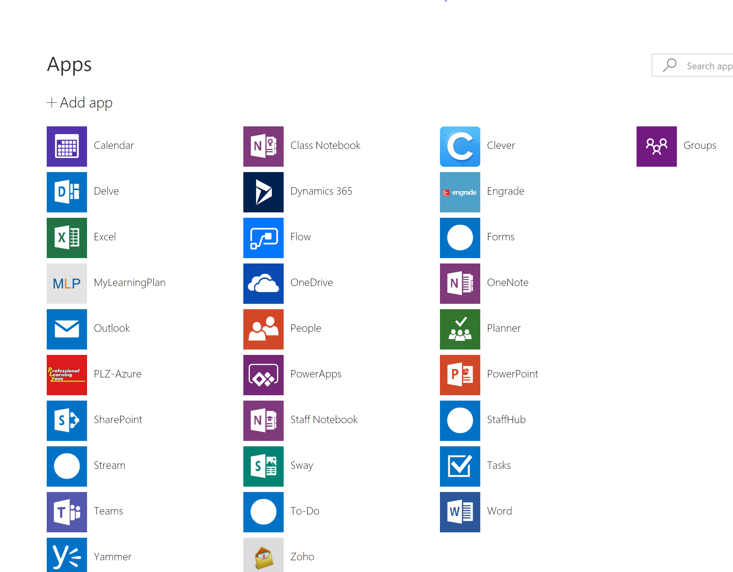
PD courses in PLZ
CLICK HERE
Notes:
30 secs
Say: You'll click on the PLZ-Azure icon.

Slide 72
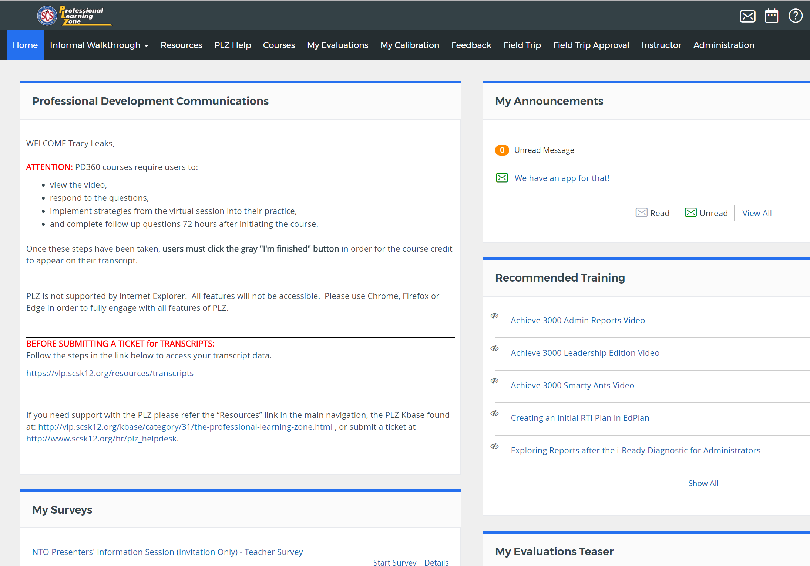
PD courses in PLZ
CLICK HERE
Notes:
30 secs
Say: Find and click on "Courses" in the menu at the top of the page.

Slide 73
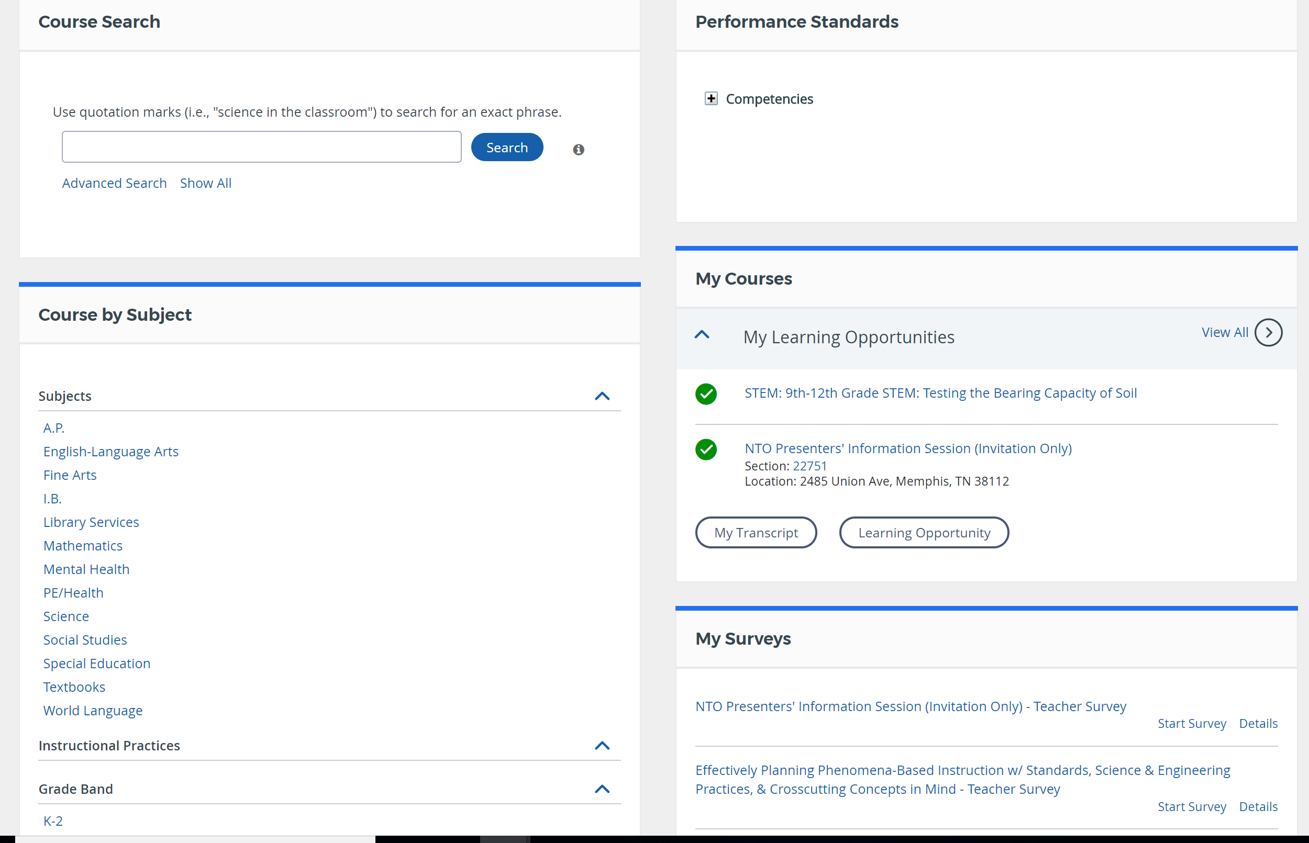
PD courses in PLZ
CLICK HERE
Notes:
30 secs
Say: Select the subject of your choice to browse all departmental courses offered or search by an exact course title if known.

Slide 74
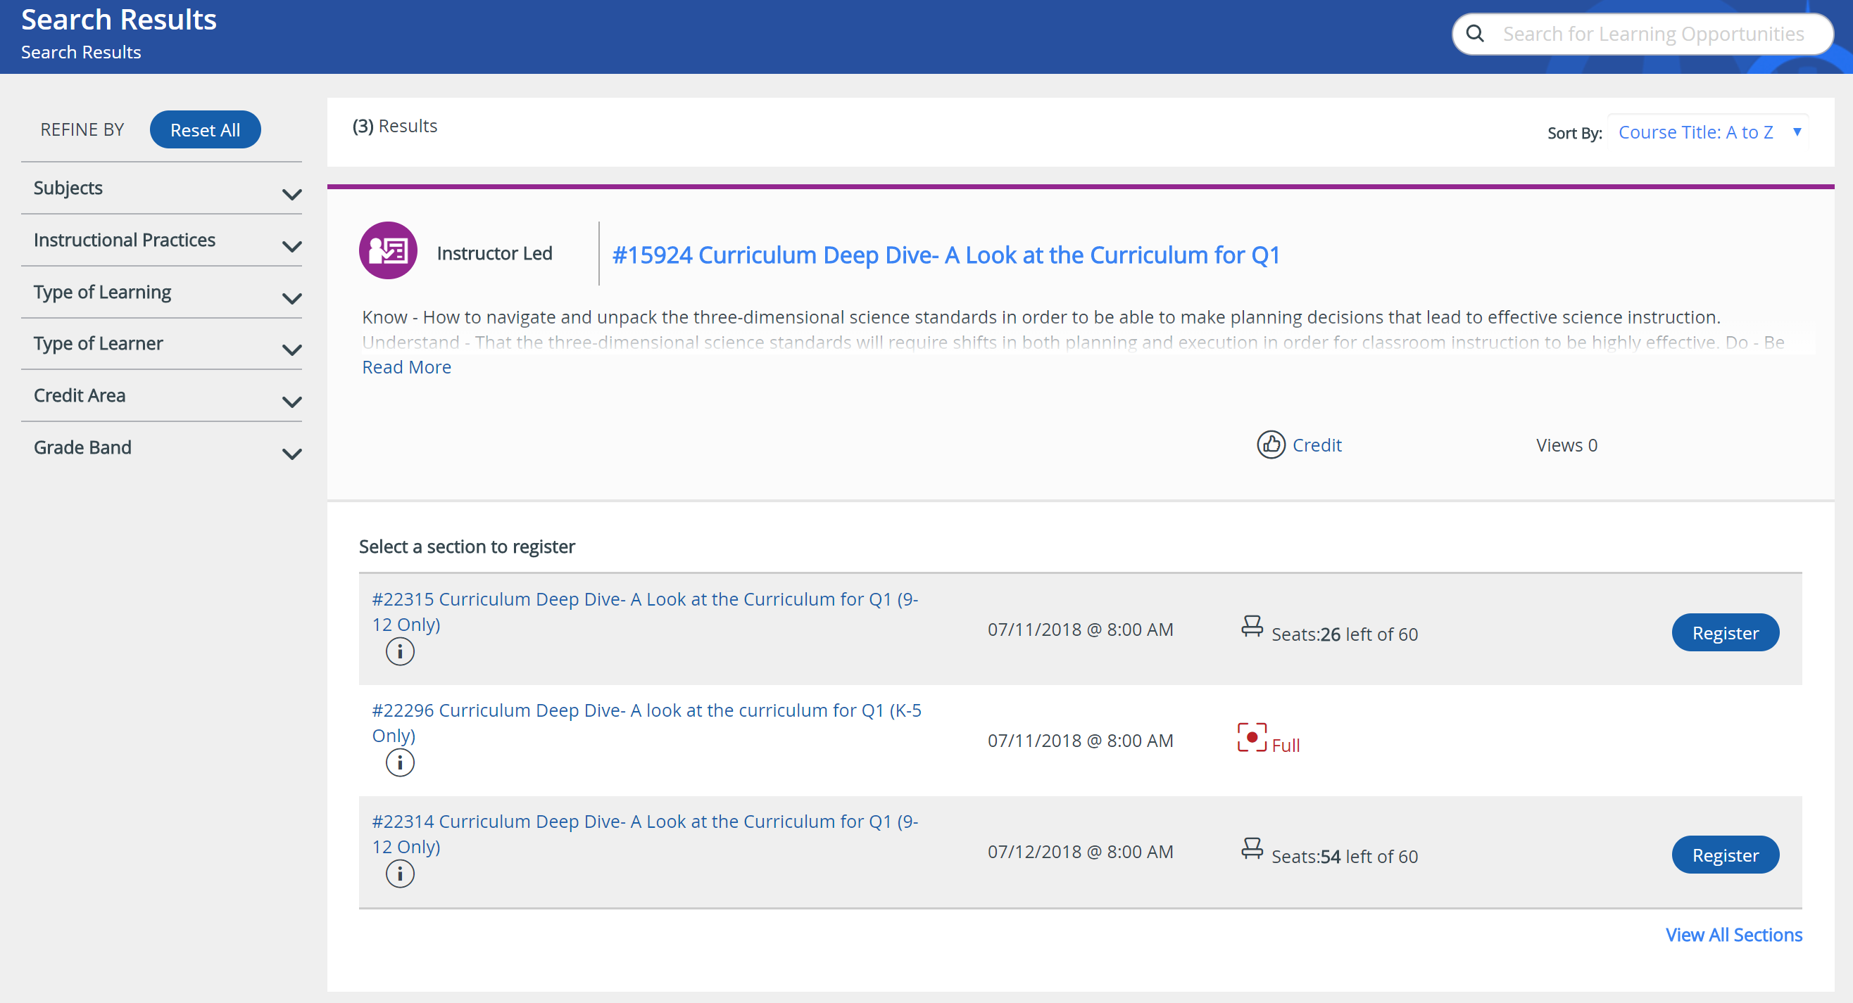
PD courses in PLZ
CLICK HERE
Notes:
30 sec
Say: A list of PD course offerings will be displayed. As you find courses that you're interested in attending, you may register by clicking on the blue register button.

Slide 75
Objectives
Know
Where to locate and how to access the curriculum map and lesson platforms.
Understand
Attaining a clear understanding of content curriculum will lead to teacher efficiency and student success.
The curriculum is grounded in information that grow students’ word and world knowledge.
Do
Navigate the curriculum to effectively prepare for executing lessons.
Notes:
1 minute

Slide 76
Survey
https://www.surveymonkey.com/r/NTOST
Notes:
We know that you have been given a lot of information in the two days you have been with us. We would like to about your experience so we can continually improve. Please take a moment to fill out our survey.
Consider playing some upbeat appropriate music while they fill the survey out

